Slide 1






Pre-Commercial Procurement
of Innovative Triage Management Systems
Strengthening Resilience and Interoperability
of Emergency Medical Services
Open Market Consultation
International
24 March 2022 11:30 – 14:15 CET
This project has received funding from the European Union’s Horizon 2020 research and innovation programme under grant agreement No 101022061.
office@iprocuresecurity.eu
pcp.iprocuresecurity.eu
@procuresecurity
Notes:
Welcome to the [Country] Open Market Consultation. This OMC is organised by [Organisation(s)] in the framework of the European project iProcure Security.

Slide 2

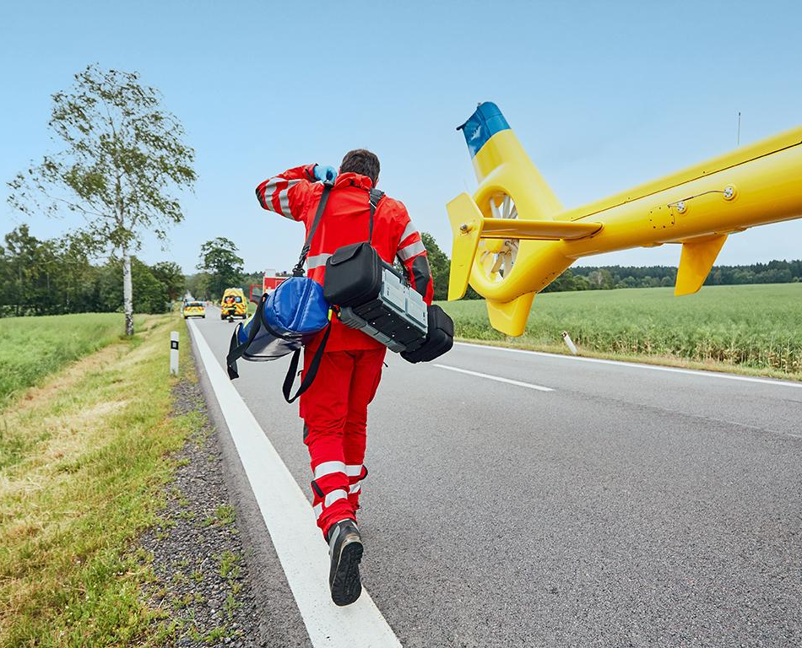




HOUSEKEEPING RULES
This session will be entirely recorded and published on the iProcureSecurity PCP website.
All participants except speakers and moderators will be muted by default.
Feel free to post your questions in the chat.
If you would like to speak, raise your hand and wait for the moderator to give you the floor.
Notes:
Please note the following housekeeping rules for this webinar.
By using your video and microphone you will be consenting to be recorded. If you do not want your voice and image to be recorded during the webinars, you may ask your questions using the chat. Consortium shall use those records for the purpose of the project only.

Slide 3
Objectives
1
Introduce the iProcureSecurity PCP project and the Call for Tenders
2
Explain the Pre-Commercial Procurement (PCP) mechanism
3
Consult with potential suppliers the draft specifications
4
Facilitate the establishment of partnerships

Slide 4


Agenda
1. WELCOME & INTRODUCTION
11:30 – 11:40
2. MAIN CHALLENGES & SCOPE
11:40 – 12:10
3. IPROCURESECURITY PCP PHASES & TENDER PROCESS
12:10 – 12:40
4. NEXT STEPS
12:40 – 12:50
5. QUESTIONS
12:50 – 13:15
6. SUPPLIER PITCHING SESSION
13:15 – 14:15
Notes:
We have divided the event into six blocks, aiming to introduce you to the main challenges and scope of the expected procurement, the specific characteristics of the pre-commercial procurement instrument, further details about the iProcure Security PCP phases and tender process, and next steps in the procurement timeline.
Finally, we have reserved enough time for your questions.

Slide 5

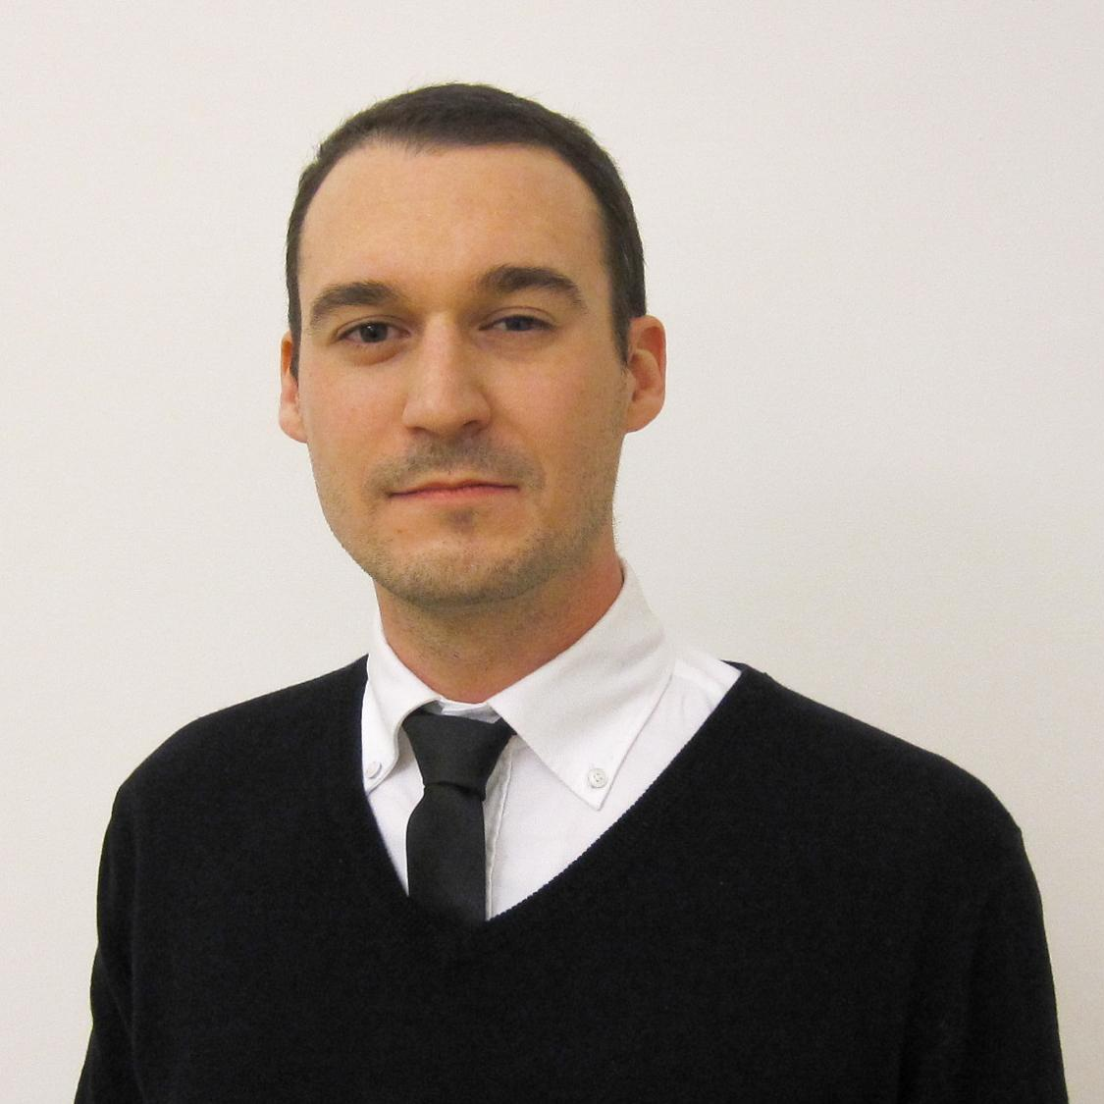

Presenters
Lucas Deimel
Research Consultant
empirica Communication and Technology Research
Bernhard Jäger
Research Manager & Department Lead
SYNYO GmbH
Eleni Lianou
Attorney-at-law
Specialist in innovation procurement
Center for Security Studies (KEMEA)

Slide 6
WELCOME & INTRODUCTION
Lucas Deimel
Research Consultant
empirica Communication and Technology Research
Notes:
I would now like to give the word to [Name] who will provide an introduction to the iProcureSecurity PCP project.

Slide 7

Current issues with triage management
Planning and decision making
Lack of clarity for the head of operations on the ground and for command and control structures and dispatch centres
Missing information on environmental conditions (traffic conditions and weather conditions)
No data for decision support to improve resource allocation and casualty transport
Resource allocation
Resource allocation is sometimes inefficient due to missing interoperability of used systems
An exhaustive analysis of the data generated in the incident is required, both in real time and afterwards
Automated monitoring of already assessed casualties can free up human resources to care for other casualties.
Notes:
Our project was started based on the need to address some challenges and inefficiencies in the current way triage management in the context of mass casualty incidents (MCI) is performed. All of us see these common challenges, which are related to different aspects of the process, including:
The planning and decision making processing during an MCI - there should be more clarity, for example, for the head of operations and for the command and control structures and dispatch centres; or better support to those roles by using real-time data like traffic and weather conditions that helps the actors make the best decision on resource allocation, transportation, etc.
Within resource allocation at MCIs, we observe often inefficiencies due to missing interoperability with the different systems and interfaces used in the process. We need rich data both during an event and following it, for evaluation and training purposes. An ICT-supported approach will help to free up human resources and enable better and quicker care of casualties

Slide 8
Current issues with triage management
Triage practice
Current triage is not very flexible
Improvement of re-triage, i.e. monitoring of the condition and vital signs of already triaged casualties
Data transmission
Radio messages are prone to confusion and slow
Interoperability
Missing interoperability (missing APIs) between applied EMS systems
Missing interoperability between all the actors participating in the emergency
Missing interoperability with national Electronic Health Record
Notes:
Further improvements are desired in the triage practice and enabling more flexibility, better communication, and better connectedness of the various actors and systems that are involved in a complex environment that is an MCI

Slide 9
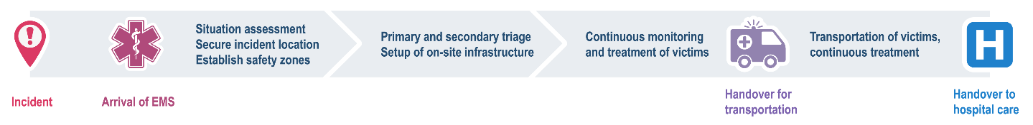
Importance of triage management
What
Sorting of casualties into priority groups according to their needs and the available resources.
Ensure the efficient use of available resources (e.g. personnel, supplies, equipment, transportation, medical facilities).
Why
Low probability but high impact of large-scale events
Affects the extent and quality of care delivered by the EMS system.
Reduced mortality and increases quality of life of casualties.
Trend
Number of natural and man-made disasters increase
Risk drivers: climate change, urbanisation, changing security landscape, technological developments
Notes:
Triage management is key for mitigating the effects of mass casualty events - a few seconds and inefficient processes can result in lost lives. Therefore, in iProcureSecurity we are are focusing on the whole process from when an incident occurs up to handover of casualties to a treatment centre or hospital.
During that time, we are looking for efficient use of resources like personnel, equipment involved in triaging casualties according to their needs.
We know that this is an important topic, because the number of natural and man-made disasters is increasing, and there are other risks that make incidents of that nature unavoidable - however, they should be managed as best as possible. Therefore we are happy to have so many participants, which hold pieces of the big puzzle that will helps us to improve our triage management.

Slide 10

The main goal of iProcureSecurity PCP is to improve triage scenarios through a flexible triage management system. 6.7 million Euros are made available for R&D services in this domain.
Notes:
The overall goal of the project is therefore to improve triage scenarios through a flexible triage management system. For that, we are offering collectively 6.7 million Euros for R&D services to address this.

Slide 11









9 procurers
from
5 countries
Responsible for the pre-hospital care of over
40 million people
Procuring organisations
KENTRO MELETON ASFALEIAS (KEMEA) – GREECE *
EMPRESA PUBLICA DE EMERGENCIAS SANITARIAS (EPES) - SPAIN
SERVICIO MADRILENO DE SALUD (SERMAS) - SPAIN
OSTERREICHISCHES ROTES KREUZ (ARC) - AUSTRIA
AGENZIA REGIONALE EMERGENZA URGENZA (AREU) - ITALY
AZIENDA SANITARIA LOCALE BENEVENTO (ASLBN) - ITALY
ELLINIKOS ERYTHROS STAVROS (HRC) - GREECE
ETHINKO KENTRO AMESIS VOITHEIAS (EKAB) - GREECE
IZMIR BUYUKSEHIR BELEDIYESI (IBB) - TURKEY
* Lead Procurer
Notes:
We are a consortium of partners - 9 procures from 5 countries which are collectively responsible for the pre-hospital care of over 40 million people. We work together with colleagues from Spain, Austria, Italy, Greece, Turkey and Germany.

Slide 12



12 partners
from
6 countries
10 advisors
160+ EMS network members
Supporting organisations
SYNYO GmbH – AUSTRIA *
ACIL AFET AMBULANS HEKIMLERI DERNEGI (AAHD) - TURKEY
EMPIRICA TECHNOLOGY RESEARCH (EMPIRICA) - GERMANY
Complemented by an Advisory Board of international EMS experts and the wider iProcureSecurity EMS Network
* Project coordinator
Notes:
The project is supported by three additional organisations who facilitate a smooth running of the pre-commercial procurement process. The coordinator of the project is SYNYO from Austria. In addition, we are being advised by many international EMS experts and the iProcureSecurity EMS network, which you can access through the project website.

Slide 13
About SYNYO
SYNYO GmbH is a highly dynamic company focusing on research, innovation and technology located in Vienna, Austria.
Objectives
SYNYO seeks to foster, develop and establish innovation, through analysis, research and development activities and has worked since 2010 with 500+partners in national and international projects.
Project Expertise
Our projects’ expertise covers (a) Setup & Management; (b) Research & Analysis; (c) Design & Implementation; (d) Dissemination & Exploitation.
Areas & Projects
Gathering experience from 60+ Research and Innovation Projects, covering a wide range of topics
- Smart Health and AAL
- Mobility and Transport
- Safety and Security
- Information Technology
- Societal Science & Society
- Smart Cities
- Sustainability and Energy
- Education

Slide 14
About KEMEA
The Center for Security Studies (Kentro Meleton Asfaleias – KEMEA) of the Hellenic Ministry of Citizen Protection (MCP) [Law 3387/2005, Article 4, Ν.3938/2011], operates as a think tank of innovation and technology in the area of national security policies (cyber and physical) and civil protection.
Objectives:
Scientific and technical support for the technological transformation of the MCP services and consultation.
Research and Development on modern operational security solutions.
Training of the operational services of the MCP and of other public or private bodies related to security and civil protection.
Sectors of Activity:
Border Security (BES)
Critical Infrastructure Protection (DRS-INFRA)
National Strategy Studies
Fight against crime & Terrorism (FCT-ISF)
Cybersecurity - Cybercrime (CYBER-DS)
International Synergies
PCP projects (Lead procurer):
iProcureSecurity PCP
PREVENT PCP
SHUTTLE
EWISA
CIVILnEXt

Slide 15
About empirica
Since 1988, internationally active Research and Consultancy Bureau from Bonn, Germany
Specialised on innovation processes and management of EU projects
eHealth, Smart Energy/Rural, Active & Healthy Aging, eCare, eSkills, Research & Innovation, Inclusive Society
200+ research & innovation projects, support actions and studies
Impact of digital transformation of the health and care sector and eHealth solutions
Political, strategic, clinical and socio-economic expertise
Previous experience from similar projects:
PCPs in general (on diabetes, hypertension and stroke)
Use of digital solutions in civil protection
Participation in European coordination exercises for EMTs and USAR (Modular Exercises - MODEX)
Notes:
Emergency Medical Teams
Urban Search and Rescue

Slide 16
Process
Pre-Commercial Procurement of R&D services
Phased approach, moving from design, through prototyping and testing
Competitive process – several contractors active in any given phase
Avoids lock-in – at least two solutions fully tested in the last phase
Notes:
Describe the PCP process characteristics in brief:
procurement of pre-commercial R&D services, that means services which are not yet market-ready
There will be different phases in which suppliers draft a solution design, build prototypes and test their advanced prototype solutions
There will always be multiple competing supplier consortia in each phase
To avoid lock-ins, at least two solutions will be piloted in the last Phase III

Slide 17
MAIN CHALLENGES & SCOPE
Bernhard Jäger
Research Manager & Department Lead
SYNYO GbmH

Slide 18
Motivation
Common needs
Quick assessment of the situation on site (e.g. number, location, status of casualties)
Better and quicker planning onsite
Reducing reaction time to changing situations
Availability of data that help to make better informed decisions
More reliable tagging of casualties
Better interoperability with all relevant agencies in onsite/at disaster area
Better distribution of resources at the scene
Increase in rapid transportation of casualties (According to their status)
Right distribution of casualties to avoid overcrowded hospitals
Notes:
Here, describe the needs from the procurer’s perspective towards innovative solutions for Triage Management and what the solutions is expected to do

Slide 19
Motivation
Innovative EMS approaches should:
make the EMS system interoperable and travel with the casualty
make the status very visible in all situations and weather conditions (night, smoke, etc.)
allow data transfer to EMS decision makers onsite and enable hem to distribute resources and organise rapid transportation of casualties
save data for analysis
help during the handover process from outside to inside hospital
allow overseeing the situation (number of casualties, location and status)
Notes:
Here, describe the needs from the procurer’s perspective towards innovative solutions for Triage Management and what the solutions is expected to do

Slide 20
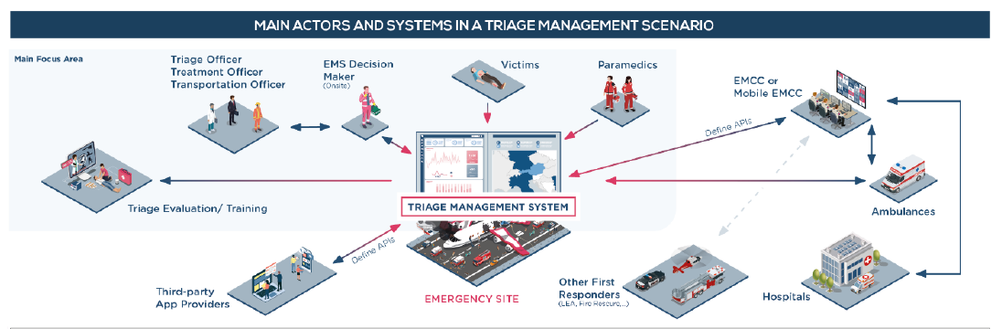
Focus on complete on-site management
… with links to further communication (e.g. EMCC) and health and care interfaces (e.g. data from triage passed on to the treatment centre / hospital)
ICT-enabled support
Solutions are expected to provide the necessary devices that work together to manage the triage process (e.g. triage tags, mobile devices)
Notes:
Describe the scope of the solution. It shall focus on on-site management of Triage (light blue box) with links to further communication (e.g., hand-over to hospitals). The iPS PCP solution is expected to be an ICT-enabled solution that comes with all required devices and software to manage triage.

Slide 21
Requirements - examples
Quick and accurate overview of casualties and their status
Distinguish different roles in the system, such as casualties, different types of EMS practitioners
Display casualties at a glance as they are being registered, their status and triage steps they are in, geolocation, etc.
Allow for identifying the casualties , e.g. by scanning their ID cards, adding a photo taken by the EMS practitioner, possibly access to the casualty‘s medical record/EHR
Provide an innovative device (tag) that can be attached to the casualty easily in different conditions and displaying information such as status, ID, as well as collecting information (e.g. vital signs, status changes) which can be viewed via appropriate interfaces by the EMS team. Further innovative elements are desirable, such as voice recognition. Some information should be visible directly on the device (e.g. circulation, breathing, disability, child/adult, stabilisation actions, exposure, bleeding/fractures/injuries, CBRN, airway, injury location, pregnancy), other information may be visible only through a connection to another interface such as a tablet.
Notes:
Talk about some examples for requirements. Here, the topic of “Quick and accurate overview of casualties and their status”. More examples on the next slides

Slide 22
Requirements - examples
Decision support for better allocation of available resources and quicker support for casualties
Allowing to quickly add new users to the system when dealing with a specific MCI, assigning roles to them and allowing them to set preferences in the system (e.g. language)
A comprehensive way of displaying the whole picture, including mapping of the MCI area and ability to add / chart elements, resources (e.g. triage stations, vehicles area, etc.) on a shared map, displaying an overview of the casualties as they are being registered in the system by on-the-ground staff, overview of checklists of important actions to take into account for the EMS onsite staff
Provide complementary information such as weather conditions, traffic conditions, surroundings

Slide 23
Requirements - examples
Decision support for better allocation of available resources and quicker support for casualties
Provide decision support based on the available data entered into the system, which supports decisions such as which hospital to select for different casualties based on available infrastructure (e.g. ICU beds) and specialisation (e.g. burns) of the hospitals nearby, required types of transportation (land/air) and number of transport vehicles, number and type of personnel, required logistic resources (supplies), etc.
Support staff management, such as staff location and types, check-in and check-out, staff progress (e.g. view of main completed tasks or checklists completed), easily communicate to the staff through the system, e.g. by sending a reminder to staff for a specific action regarding a specific casualty

Slide 24
Requirements - examples
Improved coordination and communication among the different EMS actors
Keep track of all actions – a unique record of a casualty’s journey
Share live information about red / danger zones
Store and exchange images (e.g. with EMCC)
Ensure messages are stored in case of blocked communication and are labelled clearly if they are outdated (e.g. due to missing network connection)
Reduced handover times between ambulance transport and hospitals
Display available infrastructure of hospitals nearby, their specialisation and capacity
Alert hospitals of upcoming casualties in need of treatment
Enable sending of relevant information (incl. clinical data) to those hospitals

Slide 25
Requirements - examples
Insights for quality assurance and training measures
Providing information necessary to evaluate the event ex-post (e.g. number of casualties and their status, number of vehicles and other resources used, number of EMS staff involved, used equipment, reaction times between reported actions logged in the system, collaboration with local hospitals, internal and external communication, etc.)
Offering real data from past MCI events for simulation purposes and augmented reality enabled training
Interoperability with existing systems
Use of a harmonised terminology
Connection with existing APIs and systems of the procurers (detailed in the tender documents)
Enable sharing of data with other first respondents like police and rescue (to be defined in the tender documents)
Sharing of clinical data collected onsite hospitals (EHRs)

Slide 26
Requirements - examples
Operational – during the PCP
Provide the solution in all languages of the procurers – English, Spanish, German, Italian, Greek, Turkish
Develop prototypes in two iterations (phase II) and test them with end users (n = 10 per pilot)
Fully develop the systems and test them extensively with end users (e.g. as part of national or international simulation events to be agreed with the procurers in phase III)
Ensure all equipment necessary for the solution to work (e.g. mobile devices, tags) is made available during the simulation events (plan for at least 10 end users per pilot)
Collect data in collaboration with the procurers to evaluate the solution’s effectiveness
Other – related to privacy, security, connectivity, usability, performance

Slide 27
Use cases
Existing systems integration
Identification of Use Cases, based on procurers’ inputs.
Central Information Hub
Simple Triage and Rapid Treatment
Dashboard
Use Cases as basis for the creation of Process Models.
Advanced Medical Site
Clinical Parameters collection and management
Operation Site Management
Management of vehicles and resources
Call for Tender will include:
Requirements
Use Cases
Process & Visualisation Model
Evaluation and Training
Notes:
All requirements are summarised in use cases which will describe how the solution shall function. Use cases are:
UC1: Central Information Hub
UC2: Simple Triage and Rapid Treatment
UC3: Overview of casualties and their status (continuous updated monitoring)
UC4: Advanced Medical Site (decision-support on casualty transport)
UC5: Clinical parameters collection and management
UC6: Operation site management (support with set-up of site, general management for Central Command)
UC7: Management of vehicles and resources (Logistics and required materials, in and out-flow of resources)
UC8: Evaluation and Training
UC9: Integration into legacy systems
A detailed list of all requirements and use cases will be provided in a scope document that is available on the iPS PCP website. A link to the scope document (and the supplier questionnaire at the end of the presentation).

Slide 28
IPROCURESECURITY PCP PHASES & TENDER PROCESS
Eleni Lianou
Attorney-at-law
Centre for Security Studies (KEMEA)

Slide 29
WHAT AND WHY?
Pre-Commercial Procurement (PCP) is the procurement of R&D services to develop pioneering innovative solutions, before they are commercially available
Public Procurement of Innovative solutions (PPI) happens when the public sector uses its purchasing power to act as early adopter of innovative solutions which are not yet available on large scale commercial basis
Society faces important challenges: Health care, Climate Change, Energy Efficiency, Transport, Security…
Notes:
Make clear that our project is a PCP, and there is no guarantee that a PPI will follow, this is to be decided at a later stage if some of the procurers are interested.

Slide 30
A Win-Win for everyone!
Benefits for taxpayers
Access to better public services;
More innovative and globally competitive society;
Attractive for foreign investment;
Increased employment demand.
Benefits for procurers
Benefits for suppliers
Solutions steered to public sector needs;
Increase quality of services;
Knowledge about pros/cons of alternative solutions;
Procurers get to select the best option.
Opportunities to gain leadership in a sector or to enter new markets;
Retention of IPR ownership;
Testing under real world conditions;
Shortening time-to-market for innovative products/services.

Slide 31
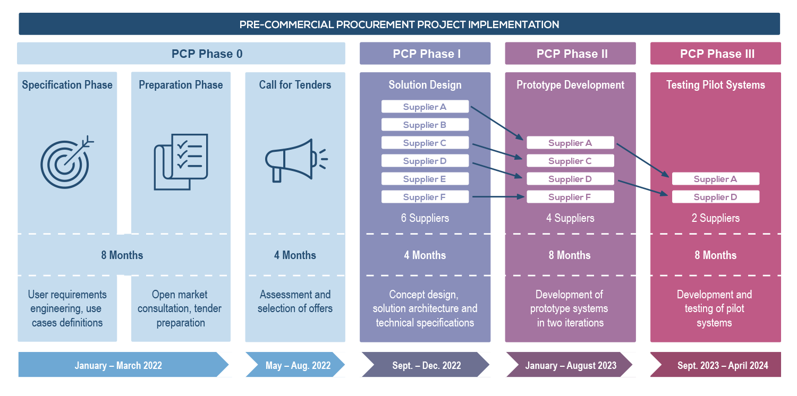
Notes:
Phase 0: procurer’s needs, requirements and use cases were collected and structured. National and international suppliers for EMS solutions are contacted and invited to OMC sessions (current phase) to discuss the funding opportunities and to receive feedback on the list of requirements. Then, the project will launch the Call for Tenders. Tenders will be received, assessed and according to clear selection criteria, tenders will be selected to participate in Phase I.

Slide 32
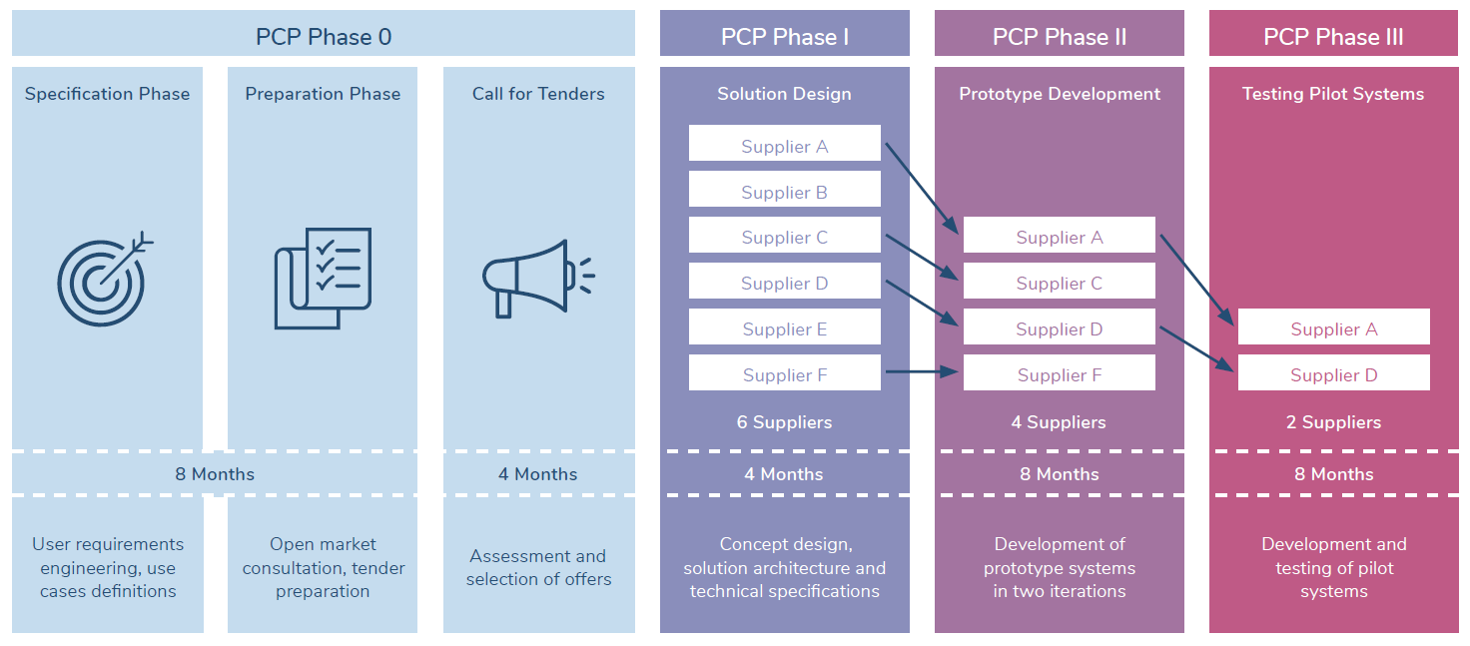
PHASE I
Concept design, solution architecture and technical specifications based on procurers’ requirements, use cases and process models
6 suppliers expected to be awarded
Expected output:
  Detailed report describing the solution and a detailed plan for the prototyping and testing activities in Phases II & III.
4 months
Maximum phase total budget: €677,419 (max. €112,903 per contractor)
  The offers are ranked according to quality – price ratio
  Contracts are awarded until the remaining budget for that phase is insufficient to contract the next best tender

Slide 33
PHASE II
Development of prototype systems in two iterations
4 suppliers expected to be awarded
Expected output:
  Prototype specification (v1)
  Prototype demonstration (v2)
  Plan for development of a limited volume of solutions for field-testing
  Updated cost/benefits forecast including a preliminary business plan
8 months
Maximum phase total budget: €2,370,967 (max. €592,742 per contractor)
  The offers are ranked according to quality – price ratio
  Contracts are awarded until the remaining budget for that phase is insufficient to contract the next best tender

Slide 34
PHASE III
Final development and testing of a limited volume of services in real world conditions
2 suppliers expected to be awarded
Expected output:
  Implementation in 5 testing sites
  Overall assessment and success verification
  Updated cost/benefits forecast, including a preliminary business plan
8 months
Maximum phase total budget: €3,725,806 (max. €1,862,903 per contractor)
  The offers are ranked according to quality – price ratio
  Contracts are awarded until the remaining budget for that phase is insufficient to contract the next best tender

Slide 35
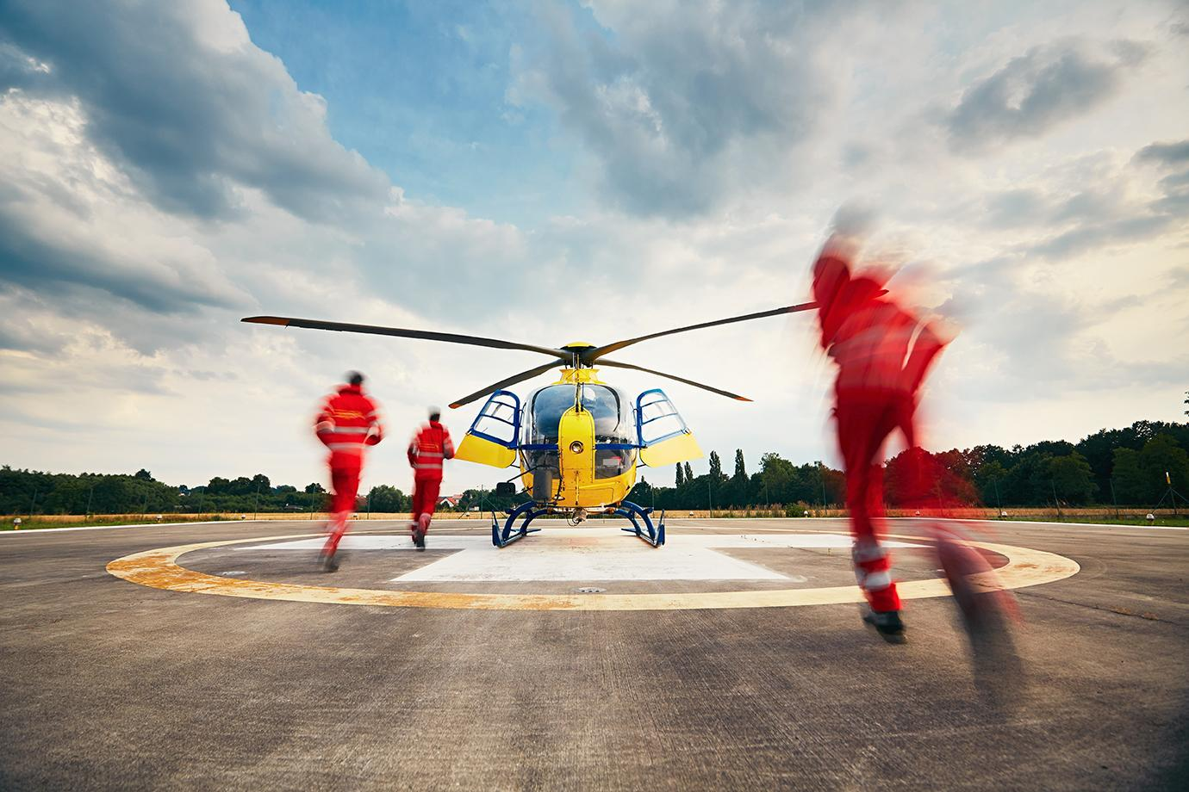
SUBMISSION OF TENDRES
ELECTRONIC SUBMISSION
(VIA DEDICATED PORTAL)
DIFFERENT SECTIONS
(ADMINISTRATIVE, TECHNICAL FINANCIAL)
5 MONTHS
TO SUBMIT OFFERS (TBC)
ENGLISH
AS THE OFFICIAL LANGUAGE
Notes:
Describe details on the tender process.

Slide 36
ELIGIBILITY & EVALUATION CRITERIA
Open to all types of operators
(companies or other type of legal entities) regardless of their size or governance structure
Single and joint tenders
OMC participation voluntary
It is not a prerequisite for participating in the Call for Tenders.
Exclusion, selection and compliance criteria
The criteria are still being developed. Internal evaluation (procurer + coordinator).
Focus on quality
The price-quality ration will favour the quality criteria.

Slide 37
Quality / price ratio example
A weight of 80/20 is given to quality and price, respectively
Score for tender
Total quality score (out of 100) for all award criteria of tender x
Cheapest Price/Price of tender X
Price weighting (20%)
Quality critera weighting
(80 %)
100
Ranked tenders are funded until the phase budget is insufficient to fund the next best tender.

Slide 38
Contract, monitoring and payments
COMPLETION CRITERIA
MONITORING
Satisfactory completion of milestones and deliverables: Requirement for payment
Successful completion: Prerequisite for passing from one phase to the next.
CONTRACTING
During each phase, contract implementation will be monitored periodically and reviewed against the expected outcomes (milestones, deliverables and output or results) for the phases.
Framework agreement with specific contracts in each phase.

Slide 39
INTELLECTUAL PROPERTY
RIGHTS
SUPPLIERS KEEP OWNERSHIP OF THE INTELLECTUAL PROPERTY RIGHTS
A FINANCIAL COMPENSATION
is to be calculated in the financial section of the tender. The actual price is the price quoted by the supplier.
The market price is the price that the supplier would have quoted.
attached to the results generated during the PCP implementation.

Slide 40
VAT
The procurement budget is centralised with the Lead Procurer (KEMEA) with headquarters in Greece. KEMEA is entitled to a deduction for input VAT. For suppliers from Greece (in the case of joint consortia, the consortium coordinator’ headquarters are of relevance) national VAT procedures apply.
Suppliers from EU member states: Invoicing without VAT using the reverse charge procedure. KEMEA’s full data and VAT number must be included. Suppliers VAT number must appear.
Suppliers from third countries: VAT is calculated and reported by KEMEA. If the supplier upon import is obliged to report VAT according to the rules of the home country and the invoice contains VAT, that VAT is non-deductible in Greece. Instead, VAT amount is to be considered as a cost of the service.
Tenderers to calculate if their net amount + VAT is still under or equal to the ceiling amount, and not higher. Example: Budget procured 124k, suppliers VAT 24 %, max. value of the service without VAT is 100k.

Slide 41
NEXT STEPS
Lucas Deimel
Research Consultant
empirica Communication and Technology Research

Slide 42
WHY AN OPEN MARKET CONSULTATION?
The OMC aims to bring the market perspective to a procurement process
It helps the procurers to prepare an effective pro-innovation tendering approach
It enables the suppliers to work in advance and prepare competitive offers.
Participation in the Open Market Consultation is not a prerequisite for participating in the Call for Tenders.

Slide 43
OMC activities
Local Events
Six local OMCs organised by each procurer in local language
International Event
OMC Questionnaire
See next slides for details.
Matchmaking
See next slides for details.
Call for Tenders
Launch expected in May.

Slide 44

We are aiming to improve the requirements with your feedback prior to the call launch
Complete the OMC questionnaire and let us know your thoughts!
QUESTIONNAIRE
SCOPE DOCUMENT
(included in the questionnaire)
https://ec.europa.eu/eusurvey/runner/OMCiProcureSecurityPCP
Obtain market feedback
Key for the success of the procurement
Notes:
The OMC questionnaire will be available in English under the following links. Requirements and Use Cases are available in the Scope Document.

Slide 45


Creation of a competitive consortium
We encourage suppliers which cannot cover the whole iProcureSecurity PCP scope to team up with other organisations.
MATCHMAKING TOOL
Fill in the Market Consultation questionnaire to get support for your partner search
https://pcp.iprocuresecurity.eu/procurementplatform/
PITCHING AT THE INTERNATIONAL WEBINAR
All presented pitching slides and the recording will be published online.
Notes:
Suppliers can register in the Matchmaking-Tool to form consortia.
During the international OMC, there will be a supplier pitching session at the end. Interested suppliers can register for the OMC and the Pitching Session on the iPS PCP website

Slide 46

Our Roadmap
Tentative timeline
01
02
03
04
05
OMC
CALL FOR TENDERS
PHASE I
PHASE II
PHASE III
Jan - Apr 22
May – Aug 22
Sep – Dec 22
Jan 23 – Aug
Sep – Apr 24

Slide 47
Q&A

Slide 48
SUPPLIER PITCHING SESSION
Lucas Deimel
Research Consultant
empirica Communication and Technology Research

Slide 49

Aim of the Session
Facilitate networking
among potential partners
Ease consortium-building
for joint tenders
Lower the barriers
for participation in the Call for Tenders

Slide 50


HOUSEKEEPING RULES
This session will be entirely recorded and published on the iProcureSecurity PCP website.
All participants must be muted when not presenting to avoid noises.
Be ready for your turn!
Stick to your 3 minutes slot.
Notes:
Please note the following housekeeping rules for this webinar.
By using your video and microphone you will be consenting to be recorded. If you do not want your voice and image to be recorded during the webinars, you may ask your questions using the chat. Consortium shall use those records for the purpose of the project only.

Slide 51
Pitching order
Black Space Technology Ltd
Bahia Software
Smart Health
Austrian Institute for Technology
AIT – Public Safety Hub
Zulu Medica S.r.l.
HighWind
APUS Software GmbH
AT-BIOTECH Traceability
Information Systems
Digito Medica
Vomatec Innovations GmbH
Vr2Go Ltd
Institute of Communication and
Computer Systems
RED Management and Consulting
Tiga Information Technologies
Inetum España, S.A.

Slide 52

Black Space Technology Ltd
United Kingdom
Medically accredited military and civilian telehealth and telemedicine software company with full language localisation with experience with multinational deployments in land, sea and air.
Value my organisation can add to a joint Tender
  12 years experience of triage solutions for mass casualty incidents – civilian and military
  Experience at design, development, integration, training and support internatonally
  Multii language interoperability linking scene to responding hospitals
  Ability to integrate 3rd party vital sign monitoring and hospital systems
  Matches hospital capacity to demand and delivers multi agency data visibility
Dr David Morgan
David.morgan@blackspacetechnology.com
https://www.blackspacetechnology.com
Areas of cooperation sought
  Communication bearer
  Hardware supply
  Local integration partners
Type of partnership
Seeking a partner
Open to discuss
The Rapid Triage System is aligned with iProcureSecurity requirements:
  Quick and accurate overview of casualties and their status
  Decision support for better allocation of available resources and quicker support for casualties
  Improved interoperability internally and with other first responders and relevant actors
  Reduced handover times between ambulance transport and hospitals
  Insights for quality assurance and training measures

Slide 53
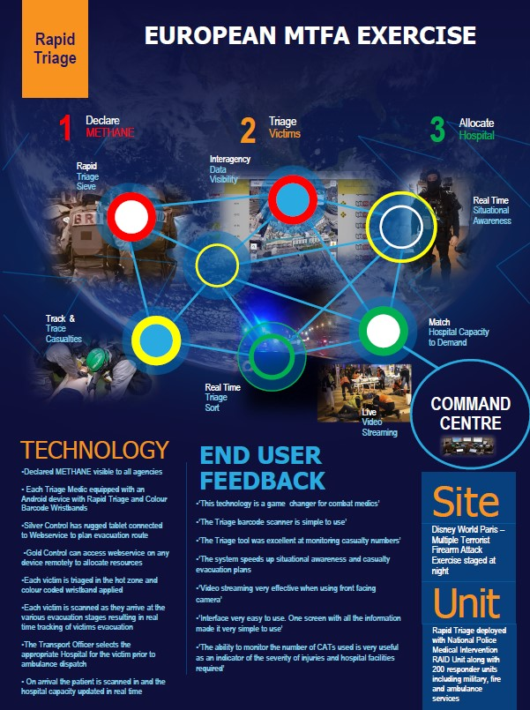
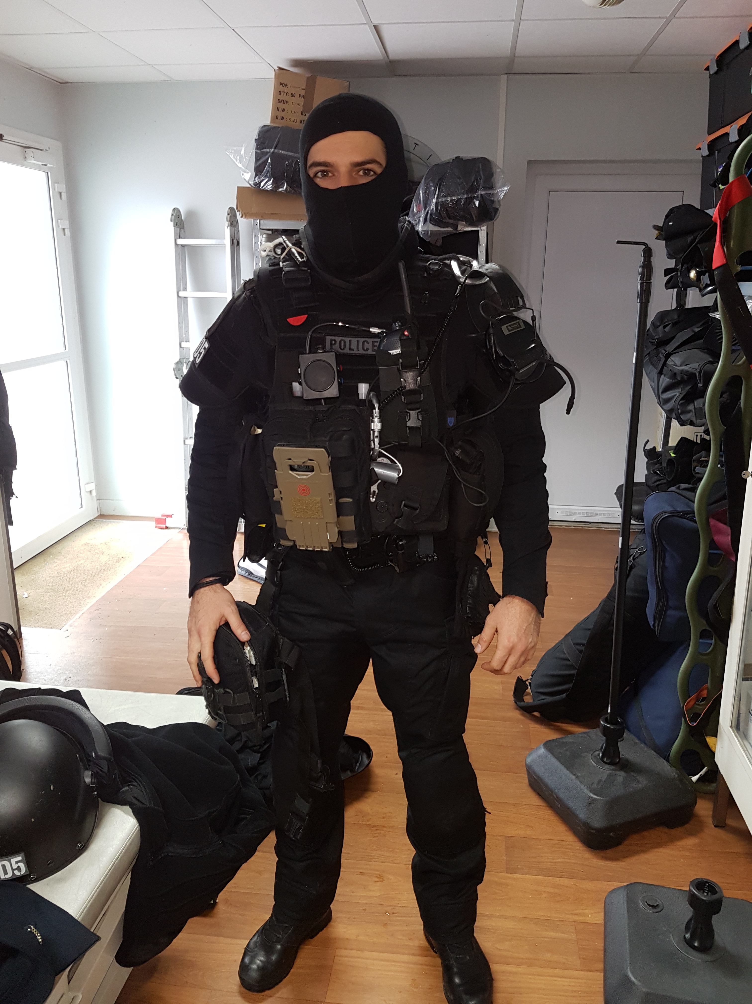
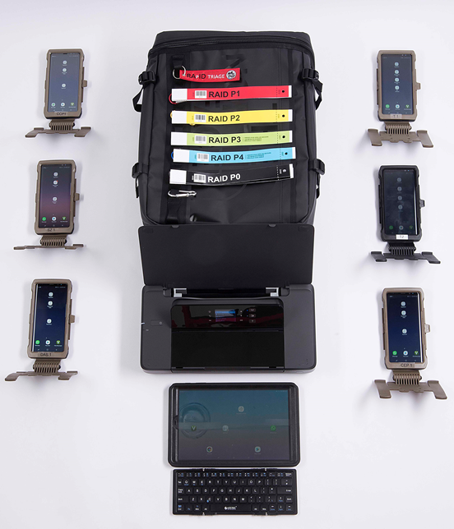
RAPID TRIAGE
CASE STUDY
RAID - France
MTFA – Disney Land
  200 Responders
  20 Hostages
  15 Terrorists
Triage
  Colour Coded Bands
  ID Terrorists
CCP
  Re-triage
  Hospital Capacity allocation
Handover
  Discharge at Scene
  Track and Trace to Hospital
Language Localisation
Kit
  6 phones, 2 tablets, 1 printer, 200 colour coded tags
CONFIDENTIAL – BLACK SPACE TECHNOLOGY 2022

Slide 54

BAHIA SOFTWARE
Spain
SME with more than 20 years in the health sector and proven experience in the development of software platforms and PCP and European R&D projects.
BAHIA SOFTWARE have also experience in triage and non-health emergencies.
Value my organisation can add to a joint Tender
  Success in developing PCP projects (leading) and H2020 projects (partner)
  Experts in interoperability in healthcare systems
  Previous experience in non-health emergency projects
  Aiming to apply satellite and drones imaging to emergencies
Cristóbal Bernardo Castiñeira
cristobal.bernardo@bahiasoftware.es
www.bahiasoftware.es
iProcureSecurity topics we are seeking cooperation
  Quick and accurate overview of casualties and their status
  Decision support for better allocation of available resources and quicker support for casualties
  Improved interoperability internally and with other first responders and relevant actors
  Reduced handover times between ambulance transport and hospitals
  Insights for quality assurance and training measures
Type of partnership
Seeking a partner
Open to discuss

Slide 55

BAHIA SOFTWARE
R&D projects
STARS PCP (leader)
  5 European hospitals as procurers
  5 partners
  Resilient support tool for pre-surgery patients to reduce stress during the entire care path
  Acomplished Phase 1 and 2
ANTISUPERBUGS PCP (leader)
  4 procuring authorities
  3 partners
  Advanced ICT solution to dectect superbugs in hospitals
  Acomplished Phase 1 and 2, and invited to Phase 3
HUTER HORIZON2020 (partner)
  Research and Innovation action from H2020 programme
  6 international partners
  Creation of the human uterus cell atlas map through single cell technologies
  Developed an ICT platform to storage, process, analyze and exploit single cell data
CHAIMELEON HORIZON2020 (partner)
  Research and Innovation action from H2020 programme
  9 European hospitals and 18 international partners
  Integration of databases of different EU hospitals into one central repository with health images and related clinical data
  Clinical data extraction into the central repository and development of analytical tools for data exploitation
EHDEN (certified SME)
  Innovative Medicines Initiative 2 Joint Undertaking programme
  Creation of a pan-European federated network using OMOP
  BAHIA SOFTWARE is a certified SME in the use of OMOP and its tools
  Transformation of 4 hospitals data bases into OMOP (Spain and Portugal)

Slide 56

Smart Health Global Solutions
SPAIN
Smart Health is a startup that provides solutions in the field of digital health specifically focused on the extra-hospital sector with the aim of guaranteeing the sustainability of the socio-health system worldwide, discovering multiple benefits for all the actors involved.
Value my organisation can add to a joint Tender
  Interoperable medical record
  Digitized medical record in 90 seconds
  Cyber Security and data privacy
  Cost reduction
  Software currently running
Gabriel Rivas
grivaas1@gmail.com
https://smarthealth.digital
Areas of cooperation sought
  Public Health Administration
  Investors
Type of partnership
Seeking a partner
Open to discuss
iProcureSecurity topics we are seeking cooperation
  Quick and accurate overview of casualties and their status
  Decision support for better allocation of available resources and quicker support for casualties
  Improved interoperability internally and with other first responders and relevant actors
  Reduced handover times between ambulance transport and hospitals
  Insights for quality assurance and training measures

Slide 57

AIT - Austrian Institute of Technology GmbH
Austria
AIT is Austrias largest applied research organisation with >1300 employees.
At the Center for Digital Safety & Security we are developing state-of-the-art information and communication technologies to ensure that IT systems are highly secure and reliable in the context of comprehensive digitization and global networking.
Value my organisation can add to a joint Tender
  Mixed Reality Trainings for training triage scenarios in an efficient and immersive way
  Exercise Instructor interface for controlling and supervising the training
  Offering a system to localize paramedics and victims via a tablet. Paramedics can type in injuries and victims get automatically localized via their location. 🡪 data is exchanged within the system and the commander has an overview where victims are and what injuries they have
Elisabeth Broneder
Elisabeth.broneder@ait.ac.at
https://www.ait.ac.at/
Areas of cooperation sought
  Co-operating with emergency coordination to localize victims
  Expertise in Mixed Reality and computer vision
  Coordinating developments
Type of partnership
Seeking a coordinator
Seeking a partner
Open to discuss
iProcureSecurity topics we are seeking cooperation
  Quick and accurate overview of casualties and their status
  Decision support for better allocation of available resources and quicker support for casualties
  Improved interoperability internally and with other first responders and relevant actors
  Reduced handover times between ambulance transport and hospitals
  Insights for quality assurance and training measures

Slide 58


AIT - Austrian Institute of Technology GmbH
Austria
AIT is Austrias largest applied research organisation with >1300 employees.
At the Center for Digital Safety & Security we are developing state-of-the-art information and communication technologies to ensure that IT systems are highly secure and reliable in the context of comprehensive digitization and global networking.
Value my organization can add to a joint Tender
  Strong expertise in IT for crisis & disaster management
  AITs Public Safety Hub (PSH) is a resilient, flexible and secure interoperability solution
  (TRL 8)
  PSH can in be used to create a common-operational-picture across organizations (backend-hub) and to exchange information from different services on-site (edge-hub)
  Existing solutions can easily be connected to the PSH as it is open for a broad range of communication protocols (CAP, EMSI, DCI, etc.)
Mario Drobics
Mario.Drobics@ait.ac.at
https://www.ait.ac.at
Areas of cooperation sought
  AIT is willing to coordinate specific areas (interoperability, requirement analysis, process design)
  AIT has expertise in public procurement and can support the application process
  AIT can support also in other areas (on-site measurements, training programs, etc.)
iProcureSecurity topics we are seeking cooperation
  Quick and accurate overview of casualties and their status
  Decision support for better allocation of available resources and quicker support for casualties
  Improved interoperability internally and with other first responders and relevant actors
  Reduced handover times between ambulance transport and hospitals
  Insights for quality assurance and training measures
Type of partnership
Seeking a coordinator
Seeking a partner
Open to discuss

Slide 59

Zulu Medical S.r.l.
Italy
Zulu Medical Srl is an innovative SME founded in 2014 and based in Treviso, near Venice.
The company has developed innovative solutions to improve communication in out-of-hospital emergency and home patient management.
Value my organisation can add to a joint Tender
  Hardware and software platform for field information collection (triage) and sharing to advanced medical stations, hospitals, operations centers, prefecture
  Continuous, updated, encrypted and unalterable data flow
  Training of personnel for the use of the platform in relation to the various intervention scenarios and related methods
  Keep in memory everything you need such as procedures, intervention protocols, sanitary, decontamination, tables chemical compound
Elettra Ricci
sales@zulumedical.net
www.zulumedical.net
Areas of cooperation sought
  Local system communication in case of no signal
  Management systems that manage the data received from the rescue site
Type of partnership
Seeking a coordinator
Seeking a partner
Open to discuss
iProcureSecurity topics we are seeking cooperation
  Quick and accurate overview of casualties and their status
  Decision support for better allocation of available resources and quicker support for casualties
  Improved interoperability internally and with other first responders and relevant actors
  Reduced handover times between ambulance transport and hospitals
  Insights for quality assurance and training measures

Slide 60
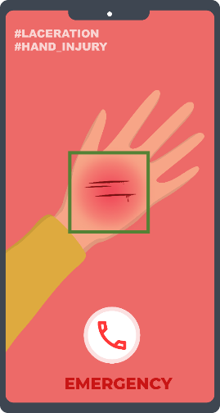
HIGHWIND
France
Start-up specialized in pre-diagnosis of emergency situations through Artificial Intelligence. Embedded within population smartphone for emergency calls or the first-responders smart devices. The AI technology allows to instantly assess patients critical level (Traumatology), elect the right emergency service, and assist triage & decisions-making during major crisis.
Value my organisation can add to a joint Tender
  Deploy an end-to-end emergency call solution, for the population & first responders to the emergency call center
  Leverage on AI to pre-diagnose patients for 1. Traumatology ; 2. Situation ; 3. Emotions & pain
  Significant time reduction and efficiency in patients assessment and triage (90ms) based on pictures
  Highlight most critical patients during major crisis
  AI pre-diagnostics module can be integrated within a partner’s end-to-end communication solution
  Simplify communication between key stakeholders (first reponders, operators, crisis cell)
Adrien RICCI
adrien.ricci@highwind-ems.com
www.highwind-ems.com
Areas of cooperation sought
  Project coordinator to ensure full project scope coverage
  Emergency communication providers looking to boost triage capabilities through AI
  Local medical emergency ecosystem knowledge
  Training for medical emergency regulators to implement new tools
Type of partnership :
Seeking a coordinator
Seeking a partner
Open to discuss
iProcureSecurity topics we are seeking cooperation
  Quick and accurate overview of casualties and their status
  Decision support for better allocation of available resources and quicker support for casualties
  Improved interoperability internally and with other first responders and relevant actors
  Reduced handover times between ambulance transport and hospitals
  Insights for quality assurance and training measures

Slide 61


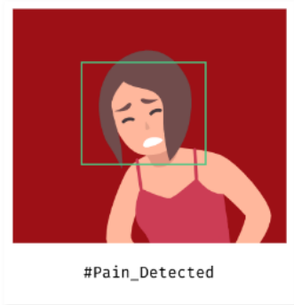
Enhanced Emergency Calls
For the public & first-responders on their smart devices
Reduce duration of medical emergency call from 12min to 2min
Increase by +50% chances of survival of the patient during the Golden Hour
SMARTPHONE EMERGENCY CALL SOLUTION
Installed app or web browser emulated via text-message (SaaS)
Triggers usual emergency call (112; 911 ; 15 ; etc), everywhere in the world
Sends : GPS/AML, photos, videos, pre-registered information
(Advanced) Pre-diagnose the situation through AI analysis in < 90ms
(Advanced) Automatically selects the right type of emergency service center through AI
DEEP-LEARNING PRE-DIAGNOSTICS MODULES
TRAUMATOLOGY
SITUATION
EMOTIONS

Slide 62
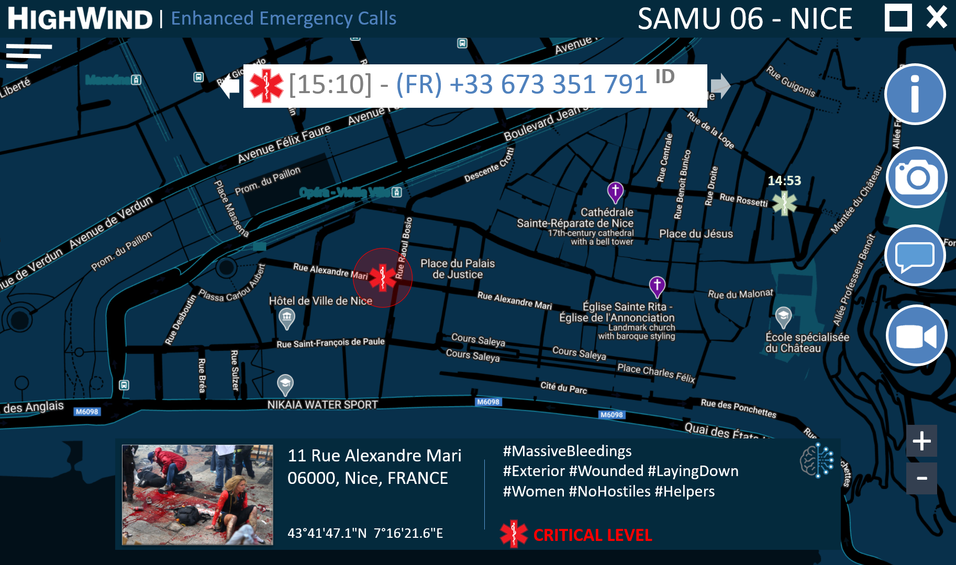
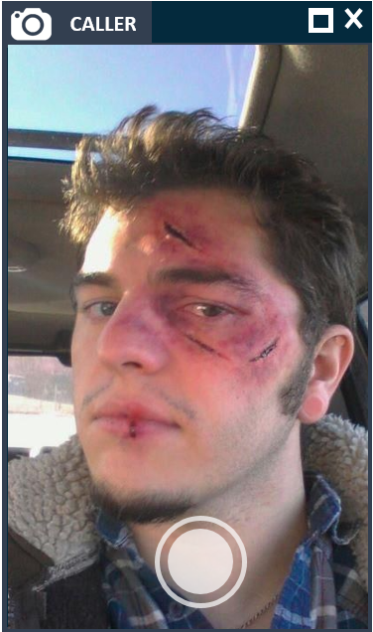
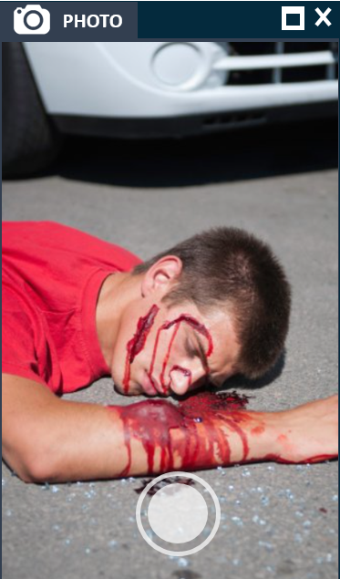
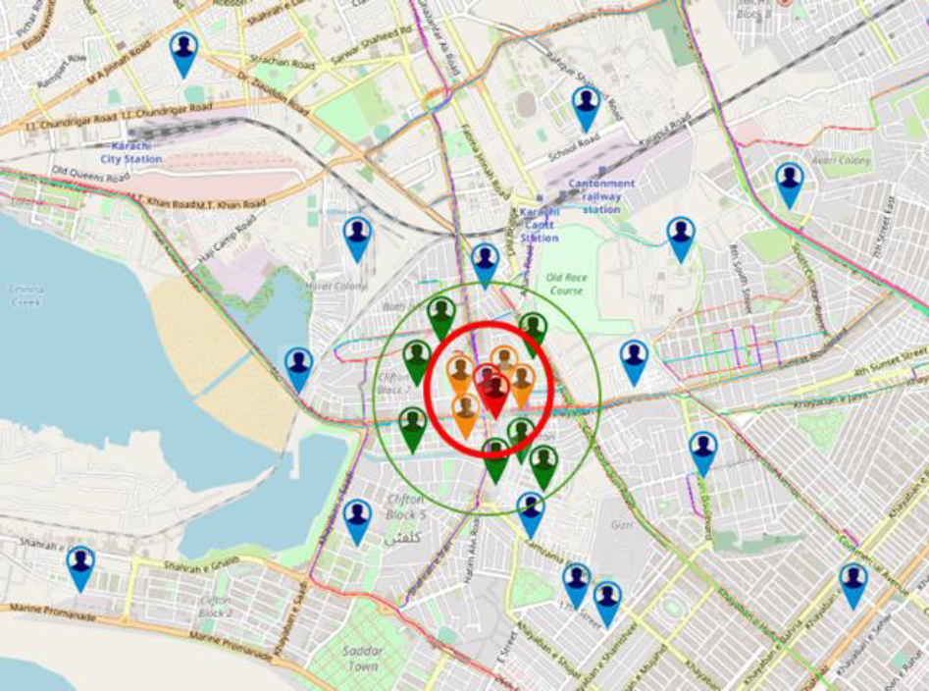
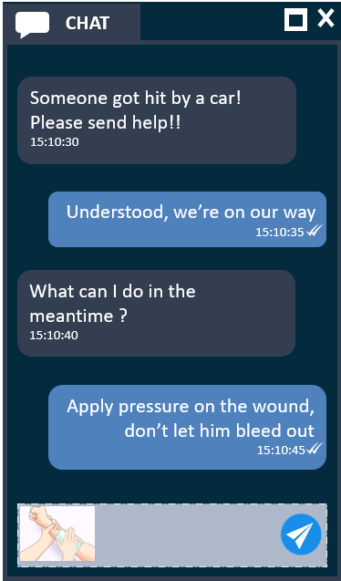
Emergency Calls & Command Center
HQ Interface dedicated to emergency call centers & crisis management teams, displayed by web browser
Emergency operators can visualize requests by emergency assessed level thanks to our AI modules

Slide 63
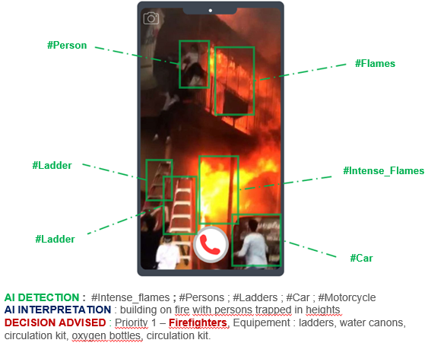
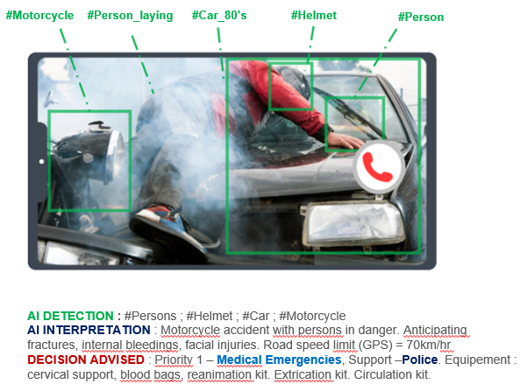
Automated Triage : Priority & Service
AI module 2 decides on the best suited emergency service, depending on each country’s practices and emergency situation context. Equipped hospitals can be automatically pre-alerted, even before call triage, to ready themselves

Slide 64

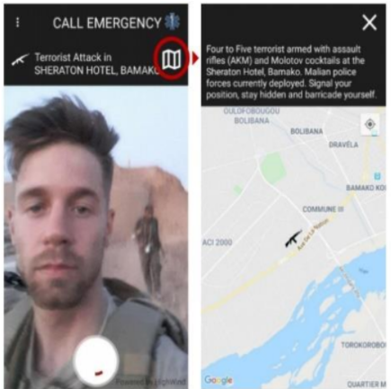
Disaster Mode
Designed with the support of disasters’ survivors and emergency responders having faced terrorist or large scale crisis situations.
Emergency notification for all persons within a given crisis’ area
Remotely activated by an emergency command center for all persons within a given area
Inform all persons of the safety measures
Enables safety check feature
Swap phone and emergency call app to “dark mode”, prevents giving away position in case of terrorist attack
Focus on battery saving and communication with reduced network

Slide 65

APUS Software GmbH
Austria
Better software, better people --- better people, better software.
The IT experts for cross-platform development and complex, fail-safe systems.
Value my organisation can add to a joint Tender
  Well-grounded experience concerning the needs and requirements of emergency and healthcare services (e.g. Red Cross, fire brigade, hospitals), national and international
  Workforce management, management of the organizational structure as an all-in-one solution
  Complete planning of all human and non-human resources for the needs-based disposition of fire services
  Integrated management of all educational measures and training courses
  Everything contained in a central planning tool
  Mobile devices and applications for reliable and effective mission dispatching
Željko Lukić
zeljko.lukic@apus.at
www.apus.at
Areas of cooperation sought
  Hospital and other healthcare provider groups
  International emergency services
  Cooperations with other stakeholders, preferably with touch points to our products and services in order to establish an encompassing triage management tool
Type of partnership
Open to discuss

Slide 66

AT-Biotech Traceability Information Systems
SPAIN
We develop RFID traceability solutions for healthcare.
Value my organisation can add to a joint Tender
  Expertise to the triage operations field: casualty identification, triage guiding, info send & receive
  Full-engineering solution: from RFID casualty bracelets to PDA devices for medical use (software, hardware, sensors)
  Robust solution working offline – all weather conditions
  Systems (software & Hardware) integration
AIDA AGEA MERINO
aida.agea@at-biotech.com
www.at-biotech.com
Areas of cooperation sought
  Full-system coordination, leadership, administration support
  GSM connectivity, other-parties interoperability, GIS (Spatial) system capabilities
  Hardware for medical vital-signs monitoring
  Legal & Regulatory requirements
Type of partnership:
Seeking a coordinator
Open to discuss
iProcureSecurity topics we are seeking cooperation
  Reduced handover times between ambulance transport and hospitals (Partial)
  Insights for quality assurance and training measures (Partial)
  Non-functional requirements: interoperability, connectivity, usability & language
  Legal & regulatory
  Organisational, Staff & Business Requirements

Slide 67
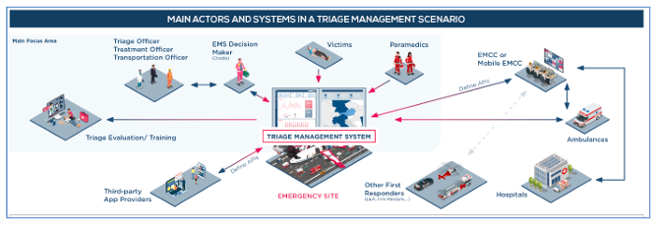
AT-Biotech Traceability Information Systems
SPAIN
We develop RFID traceability solutions for healthcare.
AIDA AGEA MERINO
aida.agea@at-biotech.com
www.at-biotech.com
Type of partnership:
Seeking a coordinator
Open to discuss
Value my organisation can add to a joint Tender
  Casualties identification, classification, location, digital record creation & update status
  Tools for medical assistance & training: process steps, onfield guiding, triage algorithms, photos attachment, multi-purpose communications device
  Casualty complete digital traceability record
  Providing data for emergency reporting, casualty-related alerts, errors prevention

Slide 68

Digito Medica
Spain
Multibrand and remote patient-monitoring connectivity and integration.
Synchronic and asynchronic communication for collaboration among Clinicians and Patients.
Remote visualization of vital markers and waves.
Value my organisation can add to a joint Tender
  Providing connectivity to monitorization devices to be used both on field and during transportation
  Providing full-disclosure remote monitorization through different visualization tools
  Providing access through mobile technology to patient Electronic Health Records.
Juan Manuel Jauregui Becker
jmjauregui@digitomedica.com
Areas of cooperation sought
  Telecommunications providers
  Analytic, AI-Based and smart triages
  Process Engineering and Process Improvement
  Logistics
Type of partnership
Seeking a partner
Open to discuss
iProcureSecurity topics we are seeking cooperation
  Quick and accurate overview of casualties and their status
  Decision support for better allocation of available resources and quicker support for casualties
  Improved interoperability internally and with other first responders and relevant actors
  Reduced handover times between ambulance transport and hospitals
  Insights for quality assurance and training measures

Slide 69

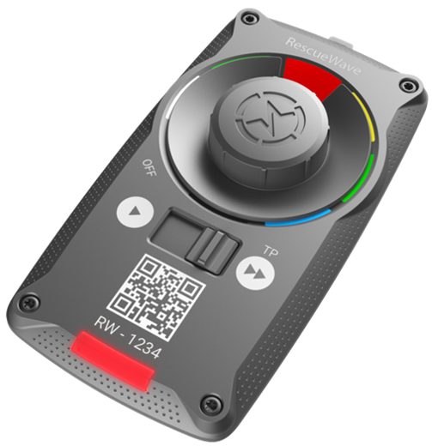

RescueWave by VOMATEC Innovations GmbH
Germany
Specialized SME from Germany.
Software and Solutions Provider for 20+ years for emergency services,
fire brigades, corporate security.
Value my organisation can add to a joint Tender
  World-First in Digital MCI Managemet
  On-Scene Overview with Digital Triage Tags (Patented)
  MCI Management Software (multi platform), from Triage to Transport
  Off-line capability,
Dr. Stephan Heuer
Stephan.Heuer@vomatec.de
www.rescuewave.de
Areas of cooperation sought
  Decision Support towards hospital capacities/infrastructure
  Privacy and GDPR
  EMCC and Hospital Information Systems
Type of partnership
Seeking a coordinator
Seeking a partner
Open to discuss
iProcureSecurity topics we are seeking cooperation
  Quick and accurate overview of casualties and their status
  Decision support for better allocation of available resources and quicker support for casualties
  Improved interoperability internally and with other first responders and relevant actors
  Reduced handover times between ambulance transport and hospitals
  Insights for quality assurance and training measures

Slide 70

Vr2Go Ltd
Israel
Specialize in creating metaverses (multiplayer virtual reality) for all use cases in a multiplayer collaboration on the cloud. Virtual Reality (VR) and PC , cross-platform support. Digital transformation from on-location processes to virtual reality environment in a cost-effective way. Data analysis for better performance.
Value my organisation can add to a joint Tender
  Save traning costs (human resources and space costs, AI actors) through VR
  Save traveling costs through VR
  More efficiant leraning processes through VR
  Recreate environmentin VR that can‘t be exist in the real world in
Zvi Tubul-Lavy
zvitubul@gmail.com
https://1sync-xr.com/
Areas of cooperation sought
  Simulation of real world situations
  Innovative learning and training methods
  Improve acquiring knowledge processes
  Improving performance by Data
Type of partnership
Seeking a coordinator
Seeking a partner
Open to discuss
iProcureSecurity topics we are seeking cooperation
  Quick and accurate overview of casualties and their status
  Decision support for better allocation of available resources and quicker support for casualties
  Improved interoperability internally and with other first responders and relevant actors
  Reduced handover times between ambulance transport and hospitals
  Insights for quality assurance and training measures

Slide 71

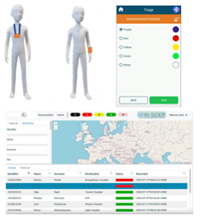
Institute of Communication and Computer Systems (ICCS) – I-SENSE Group
Greece
Research arm of the School of Electrical and Computer Engineering (ECE) of the National Technical University of Athens (NTUA) I-SENSE: Research Group of ICCS (~150 Members) active in Intelligent Transportation Systems, Virtual Environments, Smart Integrated Systems – Sensors, Communication, Platforms and Crisis Management and Secure Societies.
Value my organisation can add to a joint Tender
  Already developing, prototyping and testing (in collaboration with Medical Emergency and Civil Protection Agencies in France, Italy, Germany and UK) a Digital solution for Victim Tracking including 3D printed digital tag (NFC and Bluetooth enabled, Triage Status - LED), Mobile Application (configuration of tag, victim information/photos, victim tracking – GPS), Database and Data Distribution System (REST-API and EDXL-TEP) and Map-enabled Web Application/Dashboard
  Experienced in Embedded and Wearable Device Design and Development (incl. integration of vital sign sensors), integration of legacy systems, mobile/web applications, interoperable communications and AR applications (mobile and glasses).
  Active in related standardization (Chairing CEN Workshop Agreement on "Requirements for acquiring digital information from victims during Search and Rescue operations“ – H2020 STRATEGY)
  Coordinating the relevant RIA H2020 NIGHTINGALE and H2020 INGENIOUS
Spyros Athanasiadis spyros.athanasiadis@iccs.gr, eleftherios.ouzounoglou@iccs.gr
https://i-sense.iccs.gr/
Areas of cooperation sought (ICCS offerings)
  Digital Triage Devices for Tracking victims and their status (digital tag, communications, sensors/diagnostic device integration, GNSS)
  Mobile Application/Backend Service/Web Application/Interoperability Framework for collection and secured sharing of –Victim Information and Status –Victim Tracking and Transport Monitoring –Triage Algorithm –Interventions and Medication Given Recording
iProcureSecurity topics we are seeking cooperation
  Quick and accurate overview of casualties and their status
  Decision support for better allocation of available resources and quicker support for casualties
  Improved interoperability internally and with other first responders and relevant actors
  Reduced handover times between ambulance transport and hospitals
  Insights for quality assurance and training measures
Type of partnership
Open to discuss

Slide 72

RED Management & Consultancy
The Netherlands
(Project) management in incident, emergency, crisis and disaster management.
Tailor made trainings, courses, workshops and exercises.
Emergency Management App & Platform. (https://youtu.be/-vljTESTROM)
Value my organisation can add to a joint Tender
  20+ yrs experience in healthcare and medical emergency, crisis and disaster management.
  National and international network and experience.
  Operational, tactical and strategical experience.
  A flexible working prototype app and platform.
Raman Madan
info@red-mc.org
https://red-mc.org
Areas of cooperation sought
  Offices of Emergency Management & Emergency Medical Services.
  Corporate and Public Emergency Response providers.
  Crisis, Event & Business Continuity Managers.
  Emergency Response and Crisis Management Training institutions.
Type of partnership
Seeking a partner
Open to discuss
iProcureSecurity topics we are seeking cooperation
  Quick and accurate overview of casualties and their status
  Decision support for better allocation of available resources and quicker support for casualties
  Improved interoperability internally and with other first responders and relevant actors
  Reduced handover times between ambulance transport and hospitals
  Insights for quality assurance and training measures

Slide 73

Tiga Information Technologies
Turkey
TIGA is a technology provider focusing on dedicated Healthcare IT solutions. We provide comprehensive health ecosystems in national scale that connects all the healthcare stakeholders. We are also working closely with academia, and we give importance to industry-academia partnerships.
Value my organisation can add to a joint Tender
  Healthcare Interoperability Solutions
  125 M+ Patients, 6.6 B+ Health Records, 55 M+ Active Users, 120 K+ Healhtcare Facilities in 3 different countries
  Cloud-based Systems, Health Analytics, Main e-Health Infrastructure
  EU and R&D Project Experiences
Eda ÖZCEYHAN
Corporate Sales Executive
eda.ozceyhan@tigahealth.com
tigahealth.com
Areas of cooperation sought
  Emergency Medical Services
  IoT Tech Companies
  EMR Software Companies
  Healthcare Facilities
Type of partnership
Seeking a partner
iProcureSecurity topics we are seeking cooperation
  Quick and accurate overview of casualties and their status
  Decision support for better allocation of available resources and quicker support for casualties
  Improved interoperability internally and with other first responders and relevant actors
  Reduced handover times between ambulance transport and hospitals
  Insights for quality assurance and training measures

Slide 74

Inetum España, S.A.
Spain
Inetum is an agile IT services company that provides digital services and solutions, and a global group that helps companies and institutions to get the most out of digital flow with a complete product portfolio for healthcare.
Value my organisation can add to a joint Tender
  Solutions and Services related to critical medicine environments: Emergencies, Operating Rooms and Intensive Care Units; including follow-up of patients at discharge: continuity of care, chronicity management, outpatient care and other outpatient services
Santiago Aso Lete
santiago.aso@inetum.com
https://www.inetum.com/
Areas of cooperation sought
  Public Emergency Services
  Public Health Services
  Emergency Medical Transportation Companies
  Private Health Companies
  Insurance Companies
Type of partnership
Seeking a partner
Open to discuss
iProcureSecurity topics we are seeking cooperation
  Quick and accurate overview of casualties and their status
  Decision support for better allocation of available resources and quicker support for casualties
  Improved interoperability internally and with other first responders and relevant actors
  Reduced handover times between ambulance transport and hospitals
  Insights for quality assurance and training measures

