Slide 1






Pre-Commercial Procurement
of Innovative Triage Management Systems
Strengthening Resilience and Interoperability
of Emergency Medical Services
Open Market Consultation
ITALIA
10 Marzo 2022 ore 11:00 – 13:00 CET
This project has received funding from the European Union’s Horizon 2020 research and innovation programme under grant agreement No 101022061.
office@iprocuresecurity.eu
pcp.iprocuresecurity.eu
@procuresecurity
Notes:
Welcome to the [Country] Open Market Consultation. This OMC is organised by [Organisation(s)] in the framework of the European project iProcure Security.

Slide 2






INFO PER
PARTECIPARE
This session will be entirely recorded and published on the iProcureSecurity PCP website.
All participants except speakers and moderators will be muted by default.
Feel free to post your questions in the chat.
If you would like to speak, raise your hand and wait for the moderator to give you the floor.
Notes:
Please note the following housekeeping rules for this webinar.
By using your video and microphone you will be consenting to be recorded. If you do not want your voice and image to be recorded during the webinars, you may ask your questions using the chat. Consortium shall use those records for the purpose of the project only.

Slide 3
Objectives
1
Introduce the iProcureSecurity PCP project and the Call for Tenders
2
Explain the Pre-Commercial Procurement (PCP) mechanism
3
Consult with potential suppliers the draft specifications
4
Facilitate the establishment of partnerships

Slide 4

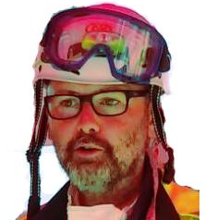
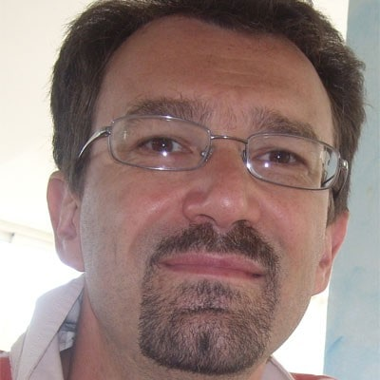

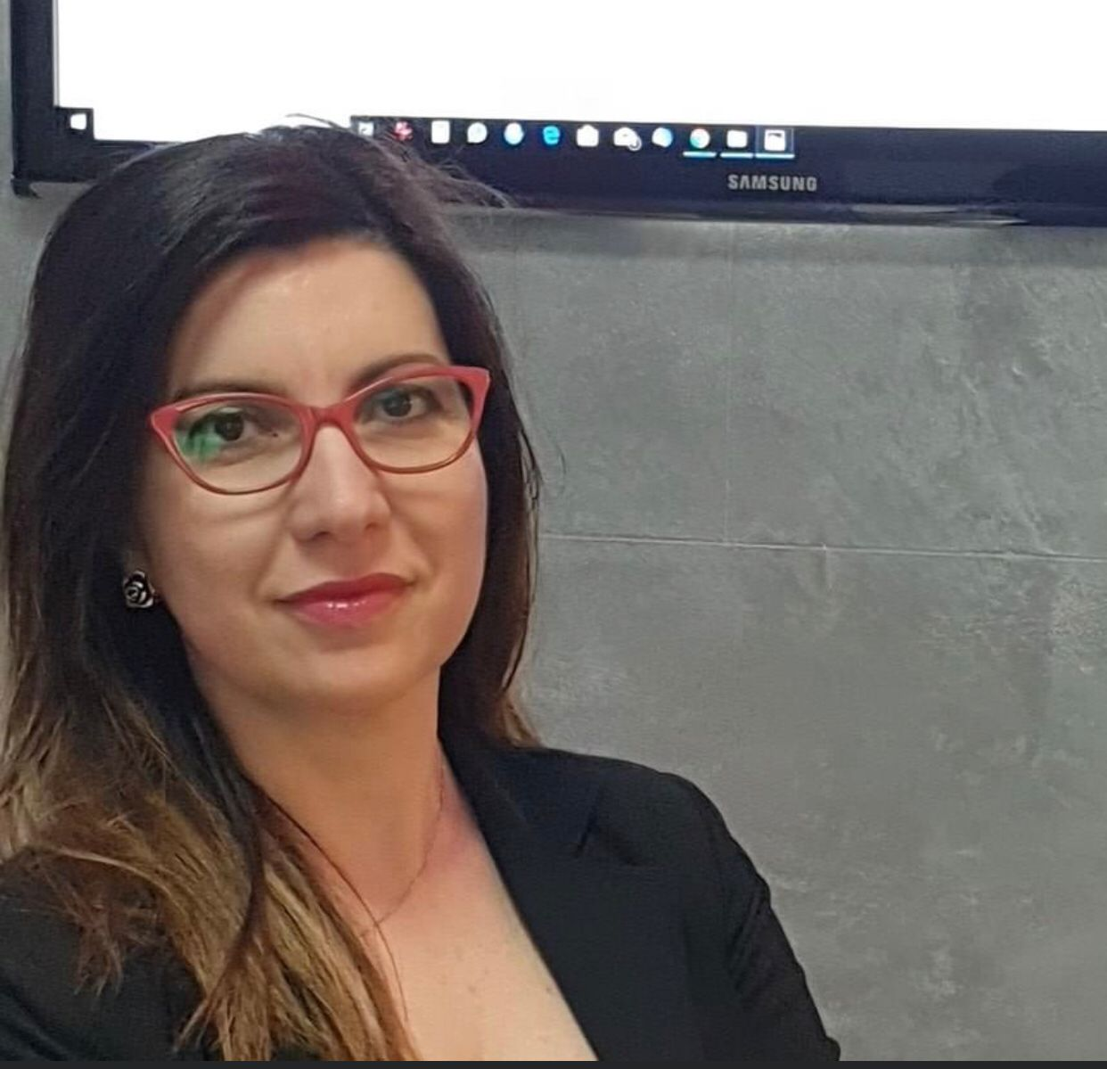
Presenters
Replace with image
Replace with image
5x5 cm
Replace with image
Replace with image
Piero Maria Brambilla
Senior Consultant
AREU, Lombardia
Andrea Comelli
Direttore "ad interim" SSD Maxiemergenza
AREU, Lombardia
Andrea Pagliosa
IT & BI Specialist
AREU, Lombardia
Alberto Lombardi
DPO - Clinical Eng.
ASL Benevento
Nadia Sgro
Project Manager
ASL Benevento

Slide 5


Agenda
1. WELCOME & INTRODUCTION
11:00-11:30
2. MAIN CHALLENGES & SCOPE
11:30-12:00
3. PRE-COMMERCIAL PROCUREMENT AS A
TOOL FOR INNOVATION PROCUREMENT
12:00-12:20
4. IPROCURESECURITY PCP PHASES & TENDER PROCESS
12:20-12:30
5. NEXT STEPS
12:30-12:40
6. QUESTIONS
12:40-13:00
Notes:
We have divided the event into six blocks, aiming to introduce you to the main challenges and scope of the expected procurement, the specific characteristics of the pre-commercial procurement instrument, further details about the iProcure Security PCP phases and tender process, and next steps in the procurement timeline.
Finally, we have reserved enough time for your questions.

Slide 6

WELCOME & INTRODUCTION
Piero Maria Brambilla
Senior Consultant
Notes:
I would now like to give the word to [Name] who will provide an introduction to the iProcureSecurity PCP project.

Slide 7

Current issues with triage management
Planning and decision making
Lack of clarity for the head of operations on the ground and for command and control structures and dispatch centres
Missing information on environmental conditions (traffic conditions and weather conditions)
No data for decision support to improve resource allocation and casualty transport
Resource allocation
Resource allocation is sometimes inefficient due to missing interoperability of used systems
An exhaustive analysis of the data generated in the incident is required, both in real time and afterwards
Automated monitoring of already assessed casualties can free up human resources to care for other casualties.
Triage practice
Current triage is not very flexible
Improvement of re-triage, i.e. monitoring of the condition and vital signs of already triaged casualties
Data transmission
Radio messages are prone to confusion and slow
Interoperability
Missing interoperability (missing APIs) between applied EMS systems
Missing interoperability between all the actors participating in the emergency
Missing interoperability with national Electronic Health Record
Notes:
Our project was started based on the need of our organisation, alongside several other organisations responsible for the procuring EMS systems in Europe, to address some challenges and inefficiencies in the current way triage management in the context of mass casualty incidents (MCI) is performed. All of us see these common challenges, which are related to different aspects of the process, including:
The planning and decision making processing during an MCI - there should be more clarity, for example, for the head of operations and for the command and control structures and dispatch centres; or better support to those roles by using real-time data like traffic and weather conditions that helps the actors make the best decision on resource allocation, transportation, etc.
Within resource allocation at MCIs, we observe often inefficiencies due to missing interoperability with the different systems and interfaces used in the process. We need rich data both during an event and following it, for evaluation and training purposes. An ICT-supported approach will help to free up human resources and enable better and quicker care of casualties
Further improvements are desired in the triage practice and enabling more flexibility, better communication, and better connectedness of the various actors and systems that are involved in a complex environment that is an MCI

Slide 8
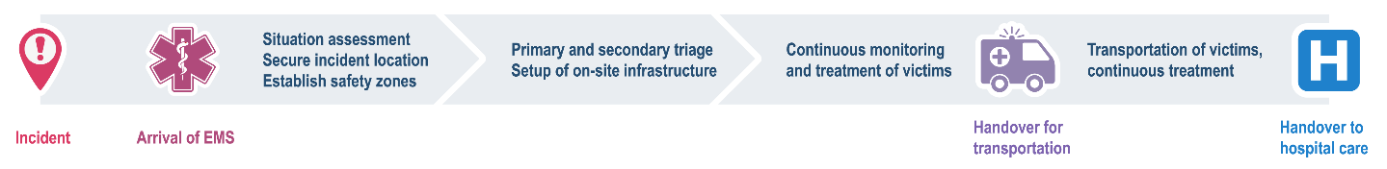
Importance of triage management
What
Sorting of casualties into priority groups according to their needs and the available resources.
Ensure the efficient use of available resources (e.g. personnel, supplies, equipment, transportation, medical facilities).
Why
Low probability but high impact of events
Affects the extent and quality of care delivered by the EMS system.
Reduced mortality and increases quality of life of casualties.
Trend
Number of natural and man-made disasters increase
Risk drivers: climate change, urbanisation, changing security landscape, technological developments
Notes:
Triage management is key for mitigating the effects of mass casualty events - a few seconds and inefficient processes can result in lost lives. Therefore, in iProcureSecurity we are are focusing on the whole process from when an incident occurs up to handover of casualties to a treatment centre or hospital.
During that time, we are looking for efficient use of resources like personnel, equipment involved in triaging casualties according to their needs.
We know that this is an important topic, because the number of natural and man-made disasters is increasing, and there are other risks that make incidents of that nature unavoidable - however, they should be managed as best as possible. Therefore we are happy to have so many participants, which hold pieces of the big puzzle that will helps us to improve our triage management.

Slide 9

L'obiettivo principale di iProcureSecurity PCP è quello di migliorare il soccorso nelle maxi-emergenze attraverso un sistema flessibile di gestione del triage.
La UE ha reso disponibili 6,7 milioni di euro per i servizi di R&S in questo settore
Notes:
The overall goal of the project is therefore to improve triage scenarios through a flexible triage management system. For that, we are offering collectively 6.7 million Euros for R&D services to address this.

Slide 10








9 partners
da
5 nazioni
responsabili per il soccorso pre-ospedaliero di
40 milioni di persone
Partners del Progetto
KENTRO MELETON ASFALEIAS (KEMEA) – GREECE *
EMPRESA PUBLICA DE EMERGENCIAS SANITARIAS (EPES) - SPAIN
SERVICIO MADRILENO DE SALUD (SERMAS) - SPAIN
OSTERREICHISCHES ROTES KREUZ (ARC) - AUSTRIA
AGENZIA REGIONALE EMERGENZA URGENZA (AREU) - ITALY
AZIENDA SANITARIA LOCALE BENEVENTO (ASLBN) - ITALY
ELLINIKOS ERYTHROS STAVROS (HRC) - GREECE
ETHINKO KENTRO AMESIS VOITHEIAS (EKAB) - GREECE
IZMIR BUYUKSEHIR BELEDIYESI (IBB) - TURKEY
* Lead Procurer
Notes:
[Your organisation] is part of a consortium of partners - 9 procures from 5 countries which are collectively responsible for the pre-hospital care of over 40 million people. We work together with colleagues from Spain, Austria, Italy, Greece, Turkey and Germany.

Slide 11



12 partners
from
6 countries
10 advisors
160+ EMS network members
Supporting organisations
SYNYO GmbH – AUSTRIA *
ACIL AFET AMBULANS HEKIMLERI DERNEGI (AAHD) - TURKEY
EMPIRICA TECHNOLOGY RESEARCH (EMPIRICA) - GERMANY
Complemented by an Advisory Board of international EMS experts and the wider iProcureSecurity EMS Network
* Project coordinator
Notes:
The project is supported by three additional organisations who facilitate a smooth running of the pre-commercial procurement process. The coordinator of the project is SYNYO from Austria. In addition, we are being advised by many international EMS experts and the iProcureSecurity EMS network, which you can access through the project website.

Slide 12
Process
Pre-Commercial Procurement of R&D services
Phased approach, moving from design, through prototyping and testing
Competitive process – several contractors active in any given phase
Avoids lock-in – at least two solutions fully tested in the last phase
Notes:
Describe the PCP process characteristics in brief:
procurement of pre-commercial R&D services, that means services which are not yet market-ready
There will be different phases in which suppliers draft a solution design, build prototypes and test their advanced prototype solutions
There will always be multiple competing supplier consortia in each phase
To avoid lock-ins, at least two solutions will be piloted in the last Phase III

Slide 13

ABOUT AREU
Piero Maria Brambilla
Senior Consultant
Notes:
I would now like to give the word to [Name] who will provide an introduction to the iProcureSecurity PCP project.

Slide 14
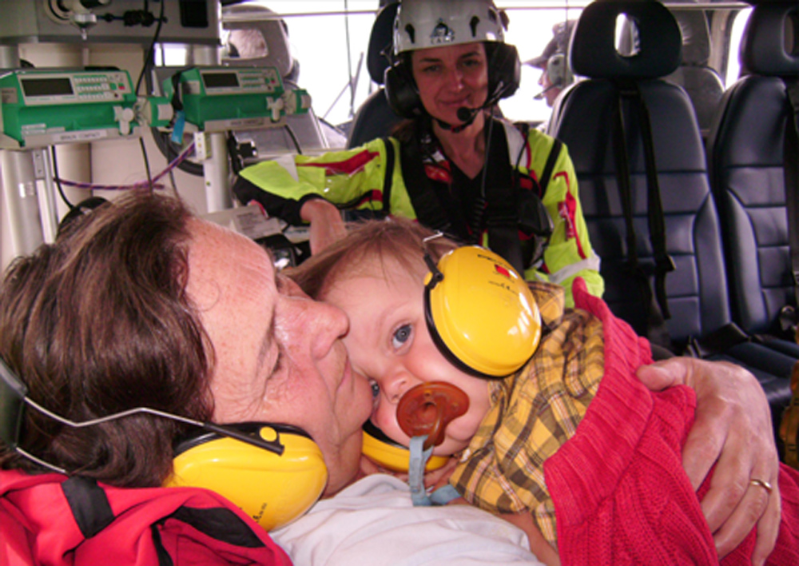
AREU - Agenzia Regionale Emergenza Urgenza
Instituted on April 2nd 2008 by the Government of Lombardy with the deliberation 6994/2008
AREU is 100% owned and financed by the Government of Lombardy
Notes:
I would now like to give the word to [Name] who will provide an introduction to the iProcureSecurity PCP project.

Slide 15

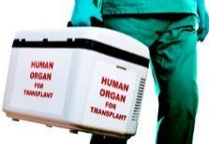

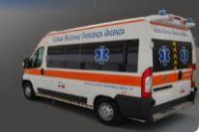


Focus
Ensure consistent and effective
Organs and Tissues transportation and crews management for Transplant activities.
Management of extra-hospital Emergency Medical Services (EMS)
exchange and compensation of blood and blood components coordinated by the Regional Coordination Structure
Non-urgent ambulance transportation services in the region
Definition, implementation and management of Regional 112 PSAPs
Social value harmonic number for non-emergency health care
for a population of 10 Millions

Slide 16
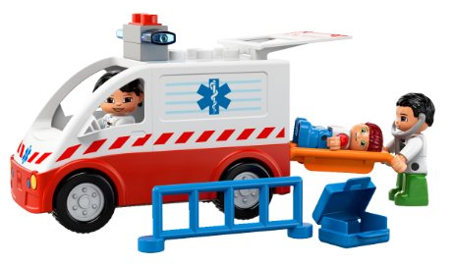
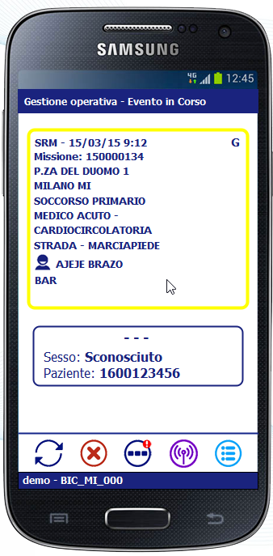
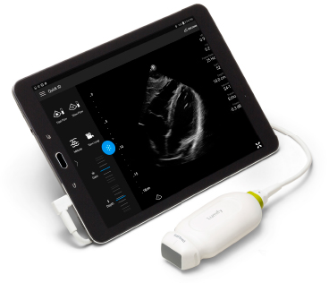
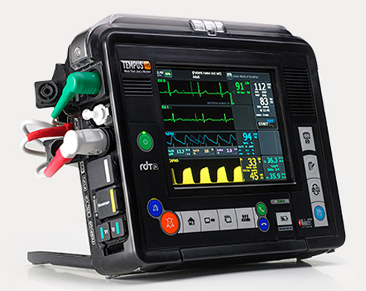
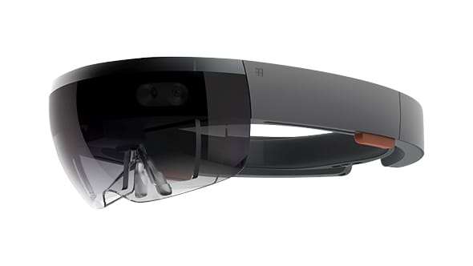
Motivation
The real motivation for seeking innovation in the area of triage is driven by the need to move from a paper-only solution to a more efficient digital solution integrated with our emergency management system used both in C&CC and in the field.
The lack of a digital triage solution is a significant limitation in terms of efficiency and effectiveness.
The most relevant results of the project will be the existence of at least one new and updated digital triage system.
This will give AREU a real chance to improve its operational capacity during major emergency events.

Slide 17





Similar projects
The HeERO projects (Harmonised eCall European pilot) funded by EU Commission under the ICT PSP program. It addresses the pan-European in-vehicle emergency call service "eCall" based on 112, the common European Emergency number.
The NEXES project (Next generation Emergency Services) funded by EU Commission under the Research and Innovation Action, aims to research, test and validate the promising integration of IP-based communication technologies and interoperability into the next generation emergency services, so that they attain increased effectiveness and performance.
EUOL (Emergency-Urgency On Line) system in Lombardy Region: real time information system among hospitals and EMS dispatch centers on the availability of “critical” resources: emergency departments, ICUs, operating rooms, cath-labs and interventional radiology, other diagnostics.
HELP 112, funded by EU Commission, is the pilot project on the design, implementation and execution of the transfer of GNSS data during a 112 call to a PSAP.
Smart Healthcare for a Smart City – Experience with Vodafone 5G network dedicated to e-health, concerning the design and implementation of smart ambulances and emergency vehicles.
Valkyries - Harmonization and Pre-Standardization of Equipment, Training and Tactical Coordinated procedures for First Aid Vehicles deployment on European multi-victim Disasters

Slide 18
Participating staff members
Piero Maria Brambilla
Senior Consultant & Advisor
Former AREU CIO & CTO
Andrea Comelli
Ad Interim Director of AREU Maxi-emergency Department
Medical Referent of Lombardy USAR Team
Gabriele Dassi
AREU CIO & CTO
System Architect
Eleonora Zucchinali
Alessandro Gervasi
Andrea Pagliosa
AREU Procurement Department Manager
AREU BI Coordinator
Expert in EMS Process Management
AREU Procurement Department Director

Slide 19

ABOUT ASL Benevento
Nadia Sgro
Project Manager
ASL Benevento

Slide 20
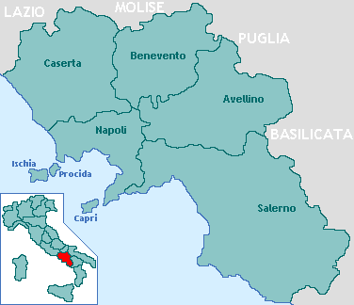

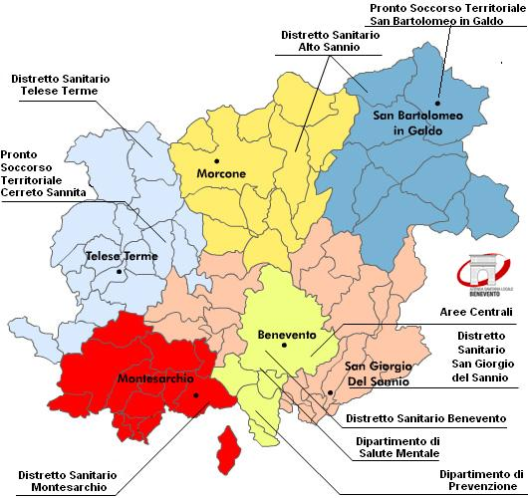
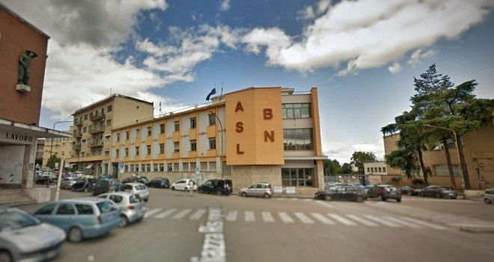

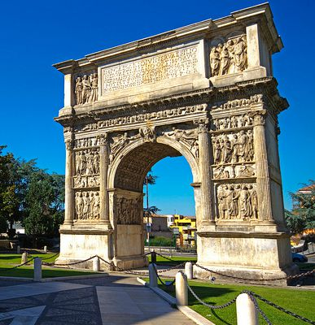
About ASL Benevento
Azienda Sanitaria Locale Benevento (ASL BN) is one of the 7 Local Health Agencies of the Campania Region. It is a public entity with managerial, technical and financial autonomy.
ASL BN manage the health issues at local level and carries out the tasks of the national health system in the geographical area of the Benevento Province.
ASL BN is characterized by:
- an area of 2000 sq km
a population of about 300.000 inhabitants
78 municipalities
ASL BN is organized in:
n.5 Healthcare Districts
n.3 multifunctional Health Departments, including Prevention and Mental Health Departments.
Emergency Medical Service of Benevento Province (Operational Center of Regional Emergency Health Service )

Slide 21

iPS Project – ASLBN TEAM
Emergency Medical Service - ASL BN
The ASL BN coordinates the Operational Center of the Benevento Province through a coordinated emergency health system.
The service is active 24 hours a day and the emergency calls are answered by a specially trained health worker directs the ambulance operators to the emergency services in the province.To allow immediate intervention, constant mapping and knowledge of the available beds in the Province Hospital, as well as constant connection with the entire regional network.
ASL Benevento has a helipad enabled for night landing located near the Benevento Hospital, to allow disadvantaged areas to be able to benefit from adequate emergency assistance in a short time.
In addition to hospitals, EMS in Benevento also relies on the provincial network of 11 emergency units located in the Benevento Province
Alberto Lombardi
Roberto De Toma
Procurement Department Director
Maria Concetta Conte
ASLBN Health Director
Data Protection Officer
Clinical Engineering Unit Manager
Health Civil Engineer
Social Health Coordination Director
Prevention and Protection Officer
HTA & Telemedicine expert
Project Management expert
Campania Region Crisis Unit Member
Alberto Lombardi
Roberto De Toma
Procurement Department Director
Maria Concetta Conte
ASLBN Health Director
Data Protection Officer
Clinical Engineering Unit Manager
Health Civil Engineer
Social Health Coordination Director
Prevention and Protection Officer
HTA & Telemedicine expert
Project Management expert
Campania Region Crisis Unit Member
Nadia Sgro
Davide Capone
Project Management expert
Samantha Canonico
Financial Administrative support
Project Management expert
Health Management Engineer
Health Management Engineer

Slide 22

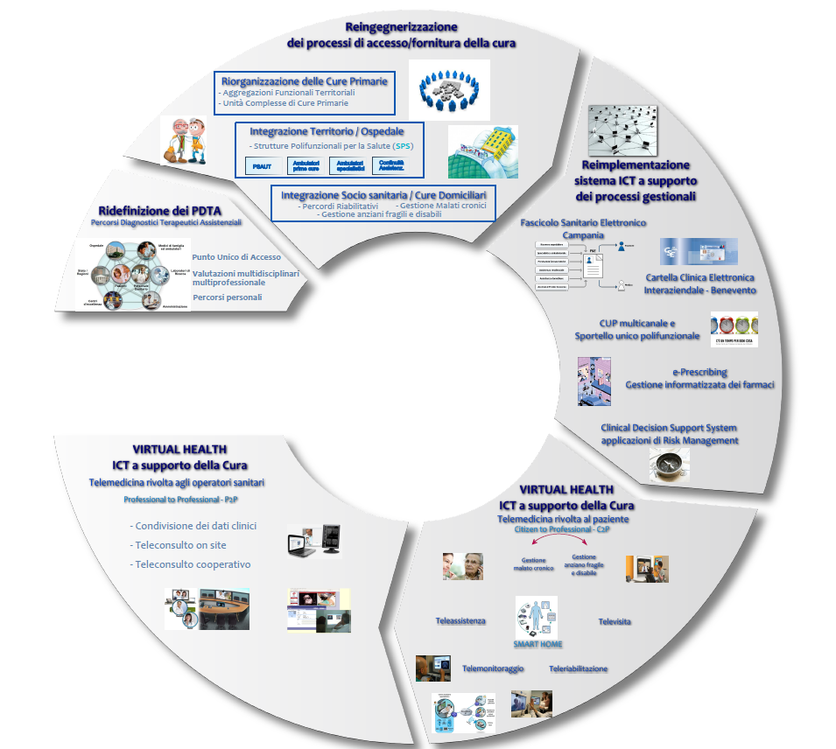
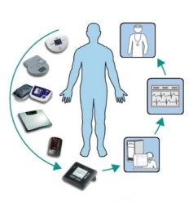


ASL BN Projects – 2020/2021
Local / National Projects
SMART CARE ASLBN Integrated Healthcare Services
SMART CARE ASLBN Telemedicine Services
RETE IMA Network for Acute Myocardial Infarction
ASL BN
SMART HEALTH
model
Horizon 2020 Projects
eCARE PCP – digital solutions supporting continuum
of care for frailty prevention in old adults
ASL BN main tasks and role in eCARE:
Lead procurer & Responsible of Procurement and Contract implementation
iProcureSecurity PCP – Innovative Triage Management System

Slide 23
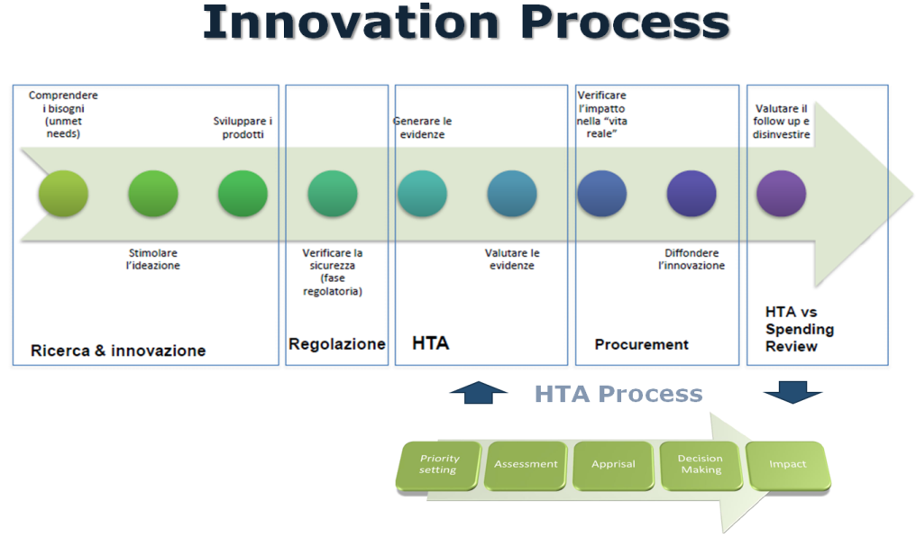




iPS Project Outcomes – ASLBN Challenges
ASL BN participates in the iPS project with the full support of the Emergency Medical Services of Campania Region and the Health Agency’s General Management.
The objective of ASL BN is to improve the quality of life of the patients, preventing diseases and managing emergencies with a multidimensional approach throught digital disruptive innovation solutions.
ASL BN Challenges:
provide its patients with innovative digital solutions for the prevention and complete management of emergency services and therapeutic diagnostic path, aimed at encouraging independent living, well-being and supporting the transition to integrated care.
improve and manage a smart and integrated emergency health management system
- develop preventive heath models, which increase the effectiveness and efficiency of health and emergency services, reducing social and economic costs.
Innovation Technology cannot be separated from the organization or from its users, but co-evolves with them, contributing to new organizational forms

Slide 24
MAIN CHALLENGES & SCOPE
Andrea Comelli
Direttore "ad interim" SSD Maxiemergenza

Slide 25
Motivation
Common needs
Quick assessment of the situation on site (e.g. number, location, status of casualties)
Better and quicker planning onsite
Reducing reaction time to changing situations
Availability of data that help to make better informed decisions
More reliable tagging of casualties
Better interoperability with all relevant agencies in onsite/at disaster area
Better distribution of resources at the scene
Increase in rapid transportation of casualties (According to their status)
Right distribution of casualties to avoid overcrowded hospitals
Innovative EMS approaches should:
make the EMS system interoperable and travel with the casualty
make the status very visible in all situations and weather conditions (night, smoke, etc.)
allow data transfer to EMS decision makers onsite and enable hem to distribute resources and
organise rapid transportation of casualties
save data for analysis
help during the handover process from outside to inside hospital
allow overseeing the situation (number of casualties, location and status)
Notes:
Here, describe the needs from the procurer’s perspective towards innovative solutions for Triage Management and what the solutions is expected to do

Slide 26
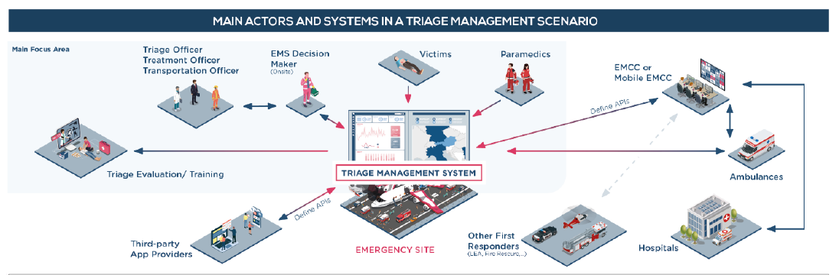
Focus on complete on-site management
… with links to further communication (e.g. EMCC) and health and care interfaces (e.g. data from triage passed on to the treatment centre / hospital)
ICT-enabled support
Solutions are expected to provide the necessary devices that work together to manage the triage process (e.g. triage tags, mobile devices)
Notes:
Describe the scope of the solution. It shall focus on on-site management of Triage (light blue box) with links to further communication (e.g., hand-over to hospitals). The iPS PCP solution is expected to be an ICT-enabled solution that comes with all required devices and software to manage triage.

Slide 27
Requirements - examples
Quick and accurate overview of casualties and their status
Distinguish different roles in the system, such as casualties, different types of EMS practitioners
Display casualties at a glance as they are being registered, their status and triage steps they are in, geolocation, etc.
Allow for identifying the casualties , e.g. by scanning their ID cards, adding a photo taken by the EMS practitioner, possibly access to the casualty‘s medical record/HER
Provide an innovative device (tag) that can be attached to the casualty easily in different conditions and displaying information such as status, ID, as well as collecting information (e.g. vital signs, status changes) which can be viewed via appropriate interfaces by the EMS team. Further innovative elements are desirable, such as voice recognition. Some information should be visible directly on the device (e.g. circulation, breathing, disability, child/adult, stabilisation actions, exposure, bleeding/fractures/injuries, CBRN, airway, injury location, pregnancy), other information may be visible only through a connection to another interface such as a tablet.
Notes:
Talk about some examples for requirements. Here, the topic of “Quick and accurate overview of casualties and their status”. More examples on the next slides

Slide 28
Requirements - examples
Decision support for better allocation of available resources and quicker support for casualties
Allowing to quickly add new users to the system when dealing with a specific MCI, assigning roles to them and allowing them to set preferences in the system (e.g. language)
A comprehensive way of displaying the whole picture, including mapping of the MCI area and ability to add / chart elements, resources (e.g. triage stations, vehicles area, etc.) on a shared map, displaying an overview of the casualties as they are being registered in the system by on-the-ground staff, overview of checklists of important actions to take into account for the EMS onsite staff
Provide complementary information such as weather conditions, traffic conditions, surroundings
Provide decision support based on the available data entered into the system, which supports decisions such as which hospital to select for different casualties based on available infrastructure (e.g. ICU beds) and specialisation (e.g. burns)of the hospitals nearby, required types of transportation (land/air) and number of transport vehicles, number and type of personnel, required logistic resources (supplies), etc.
Support staff management, such as staff location and types, check-in and check-out, staff progress (e.g. view of main completed tasks or checklists completed), easily communicate to the staff through the system, e.g. by sending a reminder to staff for a specific action regarding a specific casualty

Slide 29
Requirements - examples
Improved coordination and communication among the different EMS actors
Keep track of all actions – a unique record of a casualty’s journey
Share live information about red / danger zones
Store and exchange images (e.g. with EMCC)
Ensure messages are stored in case of blocked communication and are labelled clearly if they are outdated (e.g. due to missing network connection)
Reduced handover times between ambulance transport and hospitals
Display available infrastructure of hospitals nearby, their specialisation and capacity
Alert hospitals of upcoming casualties in need of treatment
Enable sending of relevant information (incl. clinical data) to those hospitals

Slide 30
Requirements - examples
Insights for quality assurance and training measures
Providing information necessary to evaluate the event ex-post (e.g. number of casualties and their status, number of vehicles and other resources used, number of EMS staff involved, used equipment, reaction times between reported actions logged in the system, collaboration with local hospitals, internal and external communication, etc.)
Offering real data from past MCI events for simulation purposes and augmented reality enabled training
Interoperability with existing systems
Use of a harmonised terminology
Connection with existing APIs and systems of the procurers (detailed in the tender documents)
Enable sharing of data with other first respondents like police and rescue (to be defined in the tender documents)
Sharing of clinical data collected onsite hospitals (EHRs)

Slide 31
Requirements - examples
Operational – during the PCP
Provide the solution in all languages of the procurers – English, Spanish, German, Italian, Greek, Turkish
Develop prototypes in two iterations (phase II) and test them with end users (n = 10 per pilot)
Fully develop the systems and test them extensively with end users (e.g. as part of national or international simulation events to be agreed with the procurers in phase III)
Ensure all equipment necessary for the solution to work (e.g. mobile devices, tags) is made available during the simulation events (plan for at least 10 end users per pilot)
Collect data in collaboration with the procurers to evaluate the solution’s effectiveness
Other – related to privacy, security, connectivity, usability, performance

Slide 32
Use cases
Existing systems integration
Central Information Hub
Simple Triage and Rapid Treatment
DASHBOARD
Overview of casualties and their status
Advanced Medical Site
Clinical Parameters collection and management
Operation site Management
Management of vehicles and resources
Evaluation and Training
Notes:
All requirements are summarised in use cases which will describe how the solution shall function. Use cases are:
UC1: Central Information Hub
UC2: Simple Triage and Rapid Treatment
UC3: Overview of casualties and their status (continuous updated monitoring)
UC4: Advanced Medical Site (decision-support on casualty transport)
UC5: Clinical parameters collection and management
UC6: Operation site management (support with set-up of site, general management for Central Command)
UC7: Management of vehicles and resources (Logistics and required materials, in and out-flow of resources)
UC8: Evaluation and Training
UC9: Integration into legacy systems
A detailed list of all requirements and use cases will be provided in a scope document that is available on the iPS PCP website. A link to the scope document (and the supplier questionnaire at the end of the presentation).

Slide 33
PCP AS A TOOL FOR INNOVATION PROCUREMENT
Alberto Lombardi
Data Protection Officer
Clinical Engineering Unit Manager
ASL Benevento

Slide 34
WHAT AND WHY?
Innovation Technology cannot be separated from the organization or from its users, but co-evolves with them, contributing to new organizational forms
PCP Pre Commercial Procurement
PPI Public Procurement for Innovative solutions
Notes:
Make clear that our project is a PCP, and there is no guarantee that a PPI will follow, this is to be decided at a later stage if some of the procurers are interested.

Slide 35
WHAT AND WHY?
Pre-Commercial Procurement (PCP) is the procurement of R&D services to develop pioneering innovative solutions, before they are commercially available
Public Procurement of Innovative solutions (PPI) happens when the public sector uses its purchasing power to act as early adopter of innovative solutions which are not yet available on large scale commercial basis
Society faces important challenges: Health care, Climate Change, Energy Efficiency, Transport, Security…
Notes:
Make clear that our project is a PCP, and there is no guarantee that a PPI will follow, this is to be decided at a later stage if some of the procurers are interested.

Slide 36
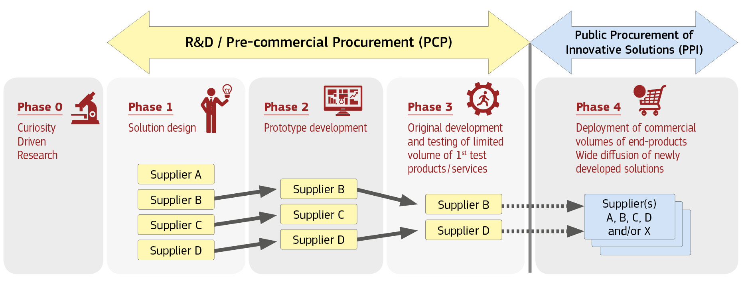
WHAT AND WHY?
Notes:
Make clear that our project is a PCP, and there is no guarantee that a PPI will follow, this is to be decided at a later stage if some of the procurers are interested.

Slide 37
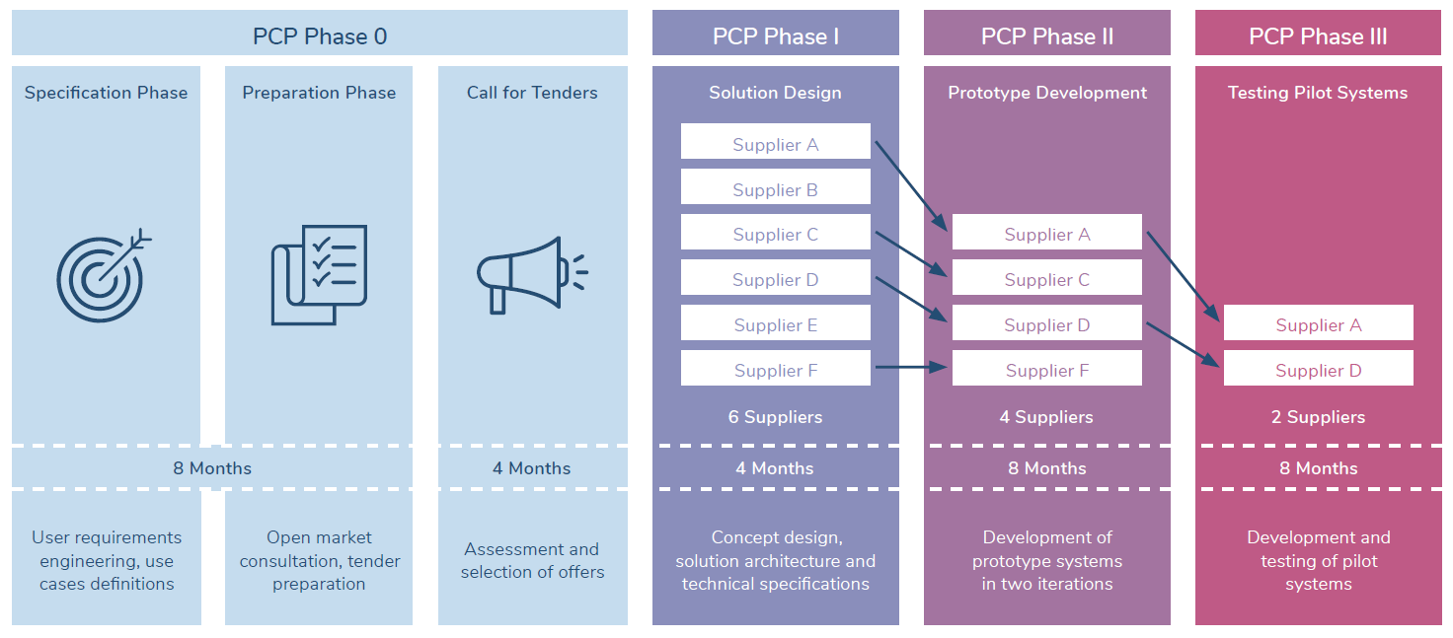
HOW?
Notes:
Here, briefly say that there will be different phases with objectives and that at the end of each Phase, suppliers will be selected to enter the next phase based on a list of selection criteria.

Slide 38
A Win-Win for everyone!
Benefits for taxpayers
Access to better public services;
More innovative and globally competitive society;
Attractive for foreign investment;
Increased employment demand.
Benefits for procurers
Benefits for suppliers
Solutions steered to public sector needs;
Increase quality of services;
Knowledge about pros/cons of alternative solutions;
Procurers get to select the best option.
Opportunities to gain leadership in a sector or to enter new markets;
Retention of IPR ownership;
Testing under real world conditions;
Shortening time-to-market for innovative products/services.

Slide 39
IPROCURESECURITY PCP PHASES & TENDER PROCESS
Alberto Lombardi
Data Protection Officer
Clinical Engineering Unit Manager
Nadia Sgro
Project Manager
ASL Benevento

Slide 40
Notes:
Phase 0: procurer’s needs, requirements and use cases were collected and structured. National and international suppliers for EMS solutions are contacted and invited to OMC sessions (current phase) to discuss the funding opportunities and to receive feedback on the list of requirements. Then, the project will launch the Call for Tenders. Tenders will be received, assessed and according to clear selection criteria, tenders will be selected to participate in Phase I.

Slide 41
PHASE I
Concept design, solution architecture and technical specifications based on procurers’ requirements, use cases and process models
6 suppliers expected to be awarded
Expected output:
  Detailed report describing the solution and a detailed plan for the prototyping and testing activities in Phases II & III.
4 months
Maximum phase total budget: €840,000 (max. €140,000 per contractor)
  The offers are ranked according to quality – price ratio
  Contracts are awarded until the remaining budget for that phase is insufficient to contract the next best tender

Slide 42
PHASE II
Development of prototype systems in two iterations
4 suppliers expected to be awarded
Expected output:
  Prototype specification (v1)
  Prototype demonstration (v2)
  Plan for development of a limited volume of solutions for field-testing
  Updated cost/benefits forecast including a preliminary business plan
8 months
Maximum phase total budget: €2,940,000 (max. €735,000 per contractor)
  The offers are ranked according to quality – price ratio
  Contracts are awarded until the remaining budget for that phase is insufficient to contract the next best tender

Slide 43
PHASE III
Final development and testing of a limited volume of services in real world conditions
2 suppliers expected to be awarded
Expected output:
  Implementation in 5 testing sites
  Overall assessment and success verification
  Updated cost/benefits forecast, including a preliminary business plan
8 months
Maximum phase total budget: €4,620,000 (max. €2,310,000 per contractor)
  The offers are ranked according to quality – price ratio
  Contracts are awarded until the remaining budget for that phase is insufficient to contract the next best tender

Slide 44
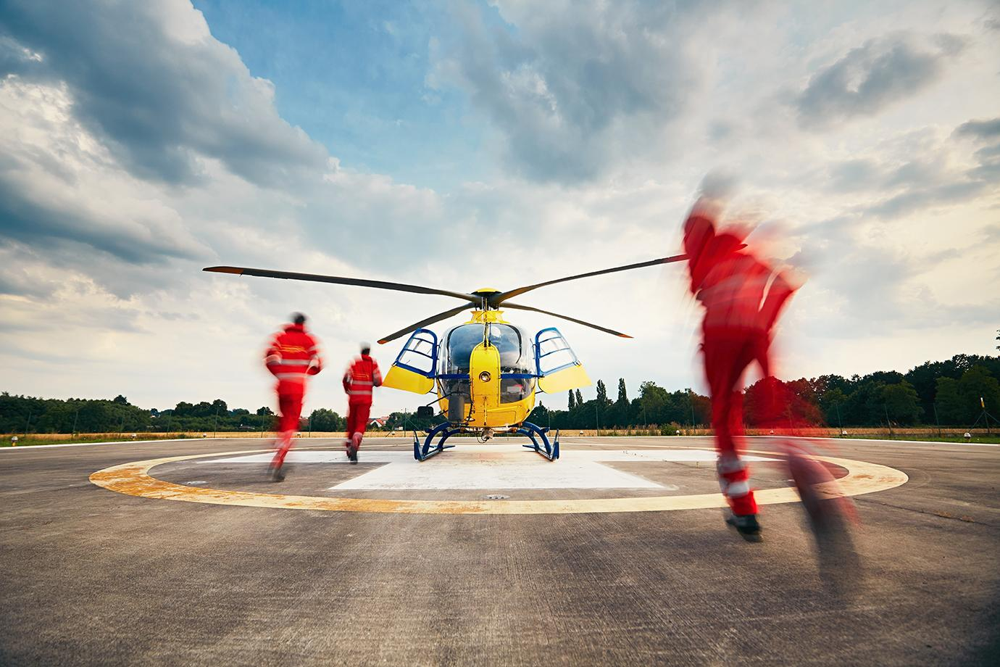
SUBMISSION OF TENDRES
ELECTRONIC SUBMISSION
(VIA DEDICATED PORTAL)
DIFFERENT SECTIONS
(ADMINISTRATIVE, TECHNICAL FINANCIAL)
5 MONTHS
TO SUBMIT OFFERS (TBC)
ENGLISH
AS THE OFFICIAL LANGUAGE
Notes:
Describe details on the tender process.

Slide 45
ELIGIBILITY & EVALUATION CRITERIA
Open to all types of operators
(companies or other type of legal entities) regardless of their size or governance structure
Single and joint tenders
OMC participation voluntary
It is not a prerequisite for participating in the Call for Tenders.
Exclusion, selection and compliance criteria
The criteria are still being developed.
Focus on quality
The price-quality ration will favour the quality criteria.

Slide 46
Quality / price ratio example
A weight of 80/20 is given to quality and price, respectively
Score for tender
Total quality score (out of 100) for all award criteria of tender x
Cheapest Price/Price of tender X
Price weighting (20%)
Quality critera weighting
(80 %)
100
Ranked tenders are funded until the phase budget is insufficient to fund the next best tender.

Slide 47
Contract, monitoring and payments
COMPLETION CRITERIA
MONITORING
Satisfactory completion of milestones and deliverables: Requirement for payment
Successful completion: Prerequisite for passing from one phase to the next.
CONTRACTING
During each phase, contract implementation will be monitored periodically and reviewed against the expected outcomes (milestones, deliverables and output or results) for the phases.
Framework agreement with specific contracts in each phase.

Slide 48
INTELLECTUAL PROPERTY
RIGHTS
SUPPLIERS KEEP OWNERSHIP OF THE INTELLECTUAL PROPERTY RIGHTS
A FINANCIAL COMPENSATION
is to be calculated in the financial section of the tender. The actual price is the price quoted by the supplier.
The market price is the price that the supplier would have quoted.
attached to the results generated during the PCP implementation.

Slide 49
VAT
The procurement budget is centralised with the Lead Procurer (KEMEA) with headquarters in Greece. KEMEA is entitled to a deduction for input VAT. For suppliers from Greece (in the case of joint consortia, the consortium coordinator’ headquarters are of relevance) national VAT procedures apply.
Suppliers from EU member states: Invoicing without VAT using the reverse charge procedure. KEMEA’s full data and VAT number must be included. Suppliers VAT number must appear.
Suppliers from third countries: VAT is calculated and reported by KEMEA. If the supplier upon import is obliged to report VAT according to the rules of the home country and the invoice contains VAT, that VAT is non-deductible in Greece. Instead, VAT amount is to be considered as a cost of the service.
Tenderers to calculate if their net amount + VAT is still under or equal to the ceiling amount, and not higher. Example: Budget procured 124k, suppliers VAT 24 %, max. value of the service without VAT is 100k.

Slide 50
NEXT STEPS
Andrea Pagliosa
IT & BI Specialist

Slide 51
WHY AN OPEN MARKET CONSULTATION?
The OMC aims to bring the market perspective to a procurement process
It helps the procurers to prepare an effective pro-innovation tendering approach
It enables the suppliers to work in advance and prepare competitive offers.
Participation in the Open Market Consultation is not a prerequisite for participating in the Call for Tenders.

Slide 52
OMC activities
Local Events
Each iProcureSecurity PCP procurer offers an event, preferably in their local language.
International Event
24 March 2022. Webinar in English for market players in addition to the local events. Supplier Pitching session. See next slides for details.
OMC Questionnaire
See next slides for details.
Matchmaking
See next slides for details.

Slide 53

We are aiming to improve the requirements with your feedback prior to the call launch
Complete the OMC questionnaire and let us know your thoughts!
QUESTIONNAIRE
SCOPE DOCUMENT
(included in the questionnaire)
Obtain market feedback
https://ec.europa.eu/eusurvey/runner/OMCiProcureSecurityPCP
Key for the success of the procurement
Notes:
The OMC questionnaire will be available in English under the following links. Requirements and Use Cases are available in the Scope Document.

Slide 54


Creation of a competitive consortium
We encourage suppliers which cannot cover the whole iProcureSecurity PCP scope to team up with other organisations.
MATCHMAKING TOOL
Fill in the Market Consultation questionnaire to get support for your partner search
pcp.iprocuresecurity.eu/matchmaking/
PITCHING AT THE INTERNATIONAL WEBINAR
Participate in in a dedicated pitching session at the international event and meet other organisations looking for partnership. If you have not yet stated a preference while registering for the OMC, send an email to office@iprocuresecurity.eu
Notes:
Suppliers can register in the Matchmaking-Tool to form consortia.
During the international OMC, there will be a supplier pitching session at the end. Interested suppliers can register for the OMC and the Pitching Session on the iPS PCP website

Slide 55

Our Roadmap
Tentative timeline
01
02
03
04
05
OMC
CALL FOR TENDERS
PHASE I
PHASE II
PHASE III
Jan - Apr 22
May – Aug 22
Sep – Dec 22
Jan – Aug 23
Sep 23 – Apr 24

Slide 56
Q&A

